Slide 1
Introduction to the Scientific Method
EINFOSE
http://einfose.ffos.hr/
Juanjo Boté| RMIS

Slide 2
Introduction
Do you know what is a Scientific Method ?

Slide 3
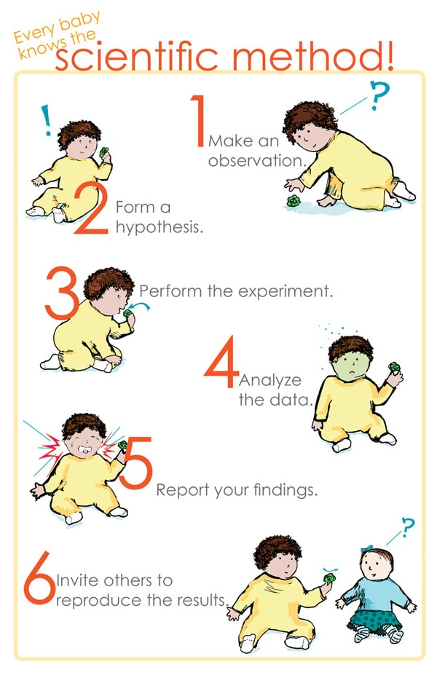
Scientific Method

Slide 4
Basic Concepts Related with Scientific Research

Slide 5
Concepts Related with Scientific Research
Scientific method
Inquiry
Science
Concepts
Research
Theory
Method

Slide 6
Science
Building and organizing knowledge
Testable explanations
Predictions about the univers

Slide 7
Science
Natural Science
Natural phenomena
Life Science
Physical Science
Chemistry, Astronomy, Earth Science
Formal Science
Formal systems
Maths, Computers, Information theory
Social Science
Concerned with society and the relationships among individuals within a society
Archaeology, Economics, Information Science

Slide 8
Cause-and-effect relationship
Lecture
Laura
Peter
Not helpful
Not helpful
Helpful
Helpful
Research
Laura
Peter
Not Interesting
Interesting
Not Interesting
Interesting

Slide 9
Cause-and-effect relationship
Variables are correlated
Cause comes before the effect
No other variables to explain the effect
A
B

Slide 10
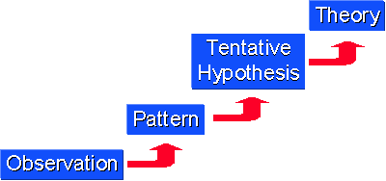
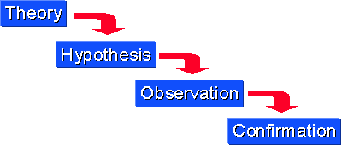
Induction vs. deduction
Inductive reasoning
moving from specific observations to broader generalizations, theories and patterns
"bottom up" approach
begin with specific observations and measures
Deductive reasoning
from the more general to the more specific
more narrow in nature and is concerned with testing or confirming hypotheses

Slide 11
Research
Investigation or experimentation aimed at the discovery and interpretation of facts, revision of accepted theories or laws in the light of new facts, or practical application of such new or revised theories or laws
“Merriam-Webster”

Slide 12
Types of research
Exploratory
Descriptive
Explanatory
Quantitative vs. qualitative

Slide 13
Types of research - Exploratory
We use exploratory research when the subject is very new
To explore the research questions.
Does not offer a final solutions to an existing problem.
Explores a range of causes and alternative options for a solution.
Usually a problem has been clearly defined
Advantages
Disadvantages
Permits changes
Permits lead futures research
Save resources in certain stages
Generates qualitative information
Biased analysis
Useless in decision making

Slide 14
Types of research - Descriptive
A study designed to depict participants in an accurate way
Observational
Case study
Survey
View and record participants
In-Depth study a group of individuals
Interviews or question with individuals

Slide 15
Types of research - Explanatory
A problem which was not well researched before, generates operational definitions and provides a better-researched model.
Starting with a general idea.
Help us in understanding the problem more efficiently.
Literature Research
Focus Group Research
Case Analysis Research

Slide 16
Types of research – Quant. vs Qual.
Quantiative research
Research applying statistics, mathemathics or computational techniques
Most used on new researchers
Qualitative research
Method of observation to gather non-numerical data

Slide 17
Types of research – Quant. vs Qual.
Quantitative research
Qualitative research
Measure Objective facts
Focus on variables
Separate theory and data
Many cases, subjects
Statistical analysis
Construct social reality, cultural meaning
Focus on interactive processes, events
Theory and data fused
Few cases, subjects
Thematic analysis

Slide 18
Method
A systematic procedure, technique, or mode of inquiry employed by or proper to a particular discipline
“Merriam-Webster”
Methodology
Social organizational context
Philosophical assumptions
Ethical principles
The political impact
Means understanding the entire research project

Slide 19
Theory
“It must accurately describe a large class of observations on the basis
of a model which contains only a few arbitrary elements, and it must make definite predictions about the results of future observations”
Stephen Hawking

Slide 20
Inquiry
Examination into facts or principles
Inquiry refers to an understanding that research is iterative

Slide 21
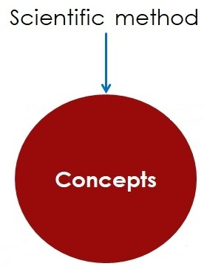
Scientific Method
Principles and procedures for the systematic pursuit of knowledge involving the recognition and formulation of a problem, the collection of data through observation and experiment, and the formulation and testing of hypotheses

Slide 22
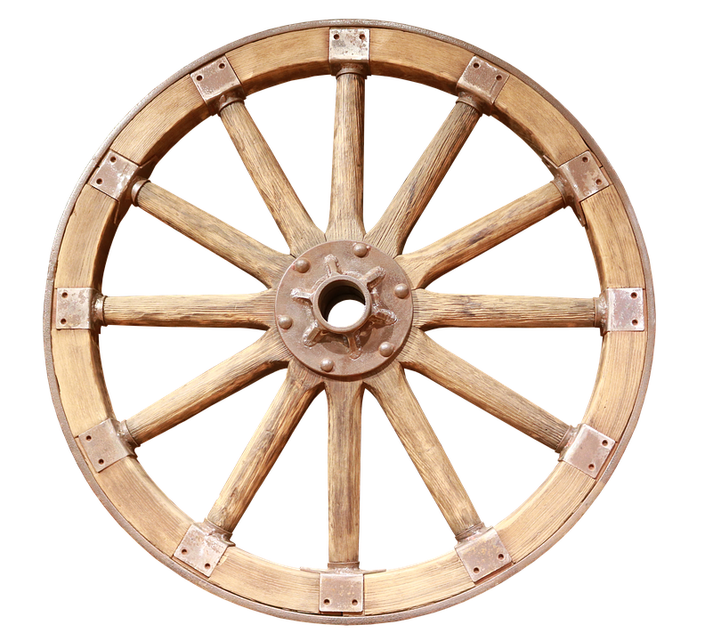
Scientific Method
Make Observations
On-going process
Develop
Theories
Questions to research
Gather Data
To test predictions
Formulate Hypothesis
Develop predictions

Slide 23
Description of the Research Question and Hypothesis Building

Slide 24
Research design
Select a topic and narrow it into a focused research question
Quantitative or qualitative?
Different perspectives – not one
Quantitative → validate a hypothesis → T or F → linear and logic research path
Qualitative → generate a new hypothesis → non linear research path

Slide 25
Research design
Some topics are fit better into qualitative. Other into quantitative
Qualitative use data to narrow the focus
Quantitative must focus without data
No design is perfect.
Time
Access to resources
Cost
Limitations

Slide 26
Research question
Must be focused
It’s a different approach

Slide 27
Types of research questions
How many students use their college library during specific time periods?
What are the subject majors of the users of a college library?

Slide 28
Variables
A variable is a concept that varies.
It may multiple values.
gender
male
female
age
14
number of robberies

Slide 29
Variables
A variable is a concept that varies.
It may multiple values.
• Dependent variable
• Independent variable
Its result comes from another variable
Its result acts on something
Z = a + b

Slide 30
Variables - examples
Library design influences on user behavior and satisfaction
Independent
Dependent
Book selection and book collection usage in academic libraries.
Independent
Dependent

Slide 31
Hypothesis
A causal hypothesis is a proposition to be tested or a tentative statement of a relationship between two variables
Newman p. 182
“Is used when a research is new”
Hypothesis is linked with a research question
Null hypothesis
No effect on the variables
independent variable has a significant effect on a dependent variable
Alternative hypothesis
Double-barreled hypothesis
Not clear the effect. Poorly designed

Slide 32
Conditions for a hypothesis
“The process starts with a set of specific facts or observations, which the researcher is attempting to explain”
Generalizability, or universality
Testable
Compatibility with existing knowledge
Invariability
Causality
Not always posible in Social Sc.
Connway & Powell, p. 52

Slide 33
Hyphotesis
Working or research hypothesis
Final hypothesis
Particular hypothesis
Causal hypothesis
Alternative hypothesis
Null hypothesis
Inductive hypothesis
Deductive hypothesis
Nondirectional hypothesis
Directional hypothesis
Multivariate hypothesis
Bivariate hypothesis
Univariate hypothesis
Connaway & Powell, p. 52

Slide 34
Sample of hypothesis
Pumpkins watered with liquid Vitamin A grow faster than pumpkins watered with liquid Vitamin B

Slide 35
Correlation vs. Causation

Slide 36
Casuality
“A type of theoretical explanation about why events occur and how things work expressed in terms of causes and effects or as one factor producing certain results.”
Neuman, 2014, p.74

Slide 37
Causality requirements
• In order to have a “cause and effect” relationship between two variables:
The two must correlate (correlation)
The cause must come before the effect (time order)
The effect cannot be explained by a third variable (spuriousness)
Babbie, 2013, p. 95

Slide 38
Causation
Neuman, p. 79

Slide 39
Criteria of Causation
Minimal conditions needed to establish a causal relationship between two items
“poverty causes crime”
“Weakening societal morals causes divorce to increase”.

Slide 40
Correlation
Correlation has a specific technical meaning and there are certain statistical requirements for it.
It indicates the strength of association…usually statistically.

Slide 41
Types of explanation - Nomothetic
Nomothetic: Relies heavily on causal laws and lawlike statements and interrelations
To explain a class of situations or events rather than a single one.
General understanding of a case.
Statistical patterns describing facts

Slide 42
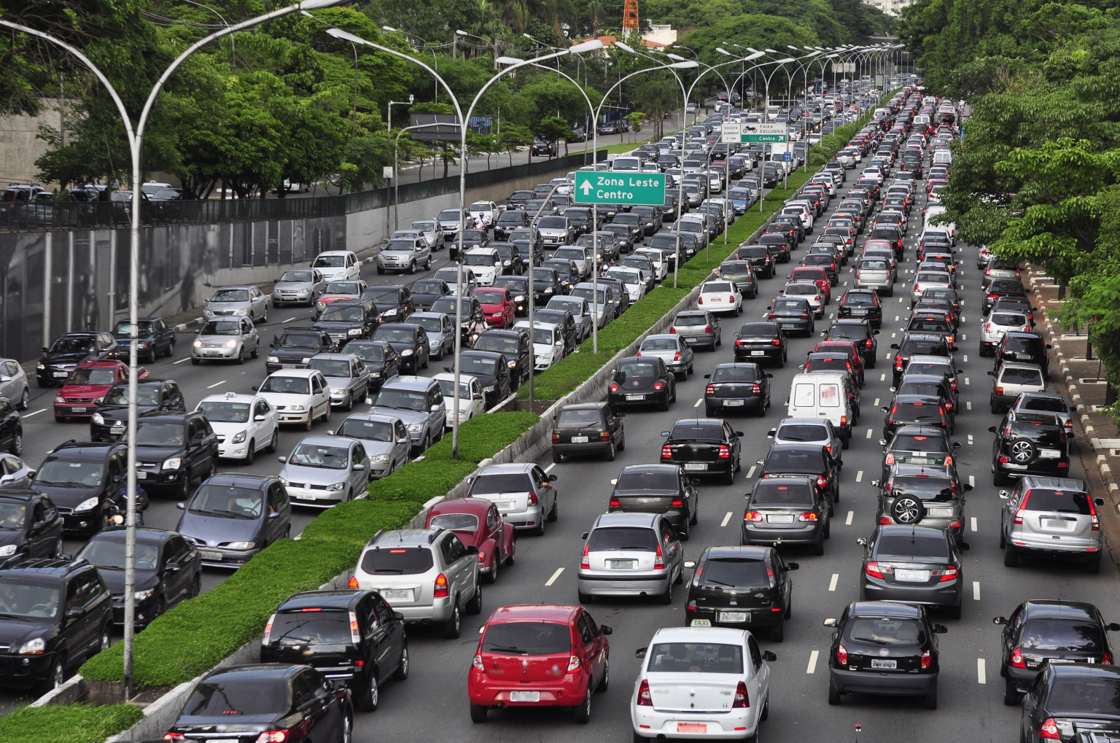
Types of explanation - Idiographic
Idiographic:
It is rich in detailed description and limited in abstraction
Esta foto de Autor desconocido está bajo licencia CC BY-NC-SA

Slide 43
Conceptualization, Operationalization and Measurement

Slide 44
Levels of measurement - Scales
Nominal
Ordinal
Social class, prejudice, etc
>, >=, <, <=
Gender: Male, Female
Interval
Ratio
IQ, degrees of temperature
Age, income, number of times married

Slide 45
Validity and reliability
Research is valid when the conclusions are true
Research is reliable when findings are repeteable

Slide 46
Reliability
The design of a research study is reliable when its findings are
repeatable or replicable and generalizable beyond the one study
Adapted from Connaway, p. 65

Slide 47
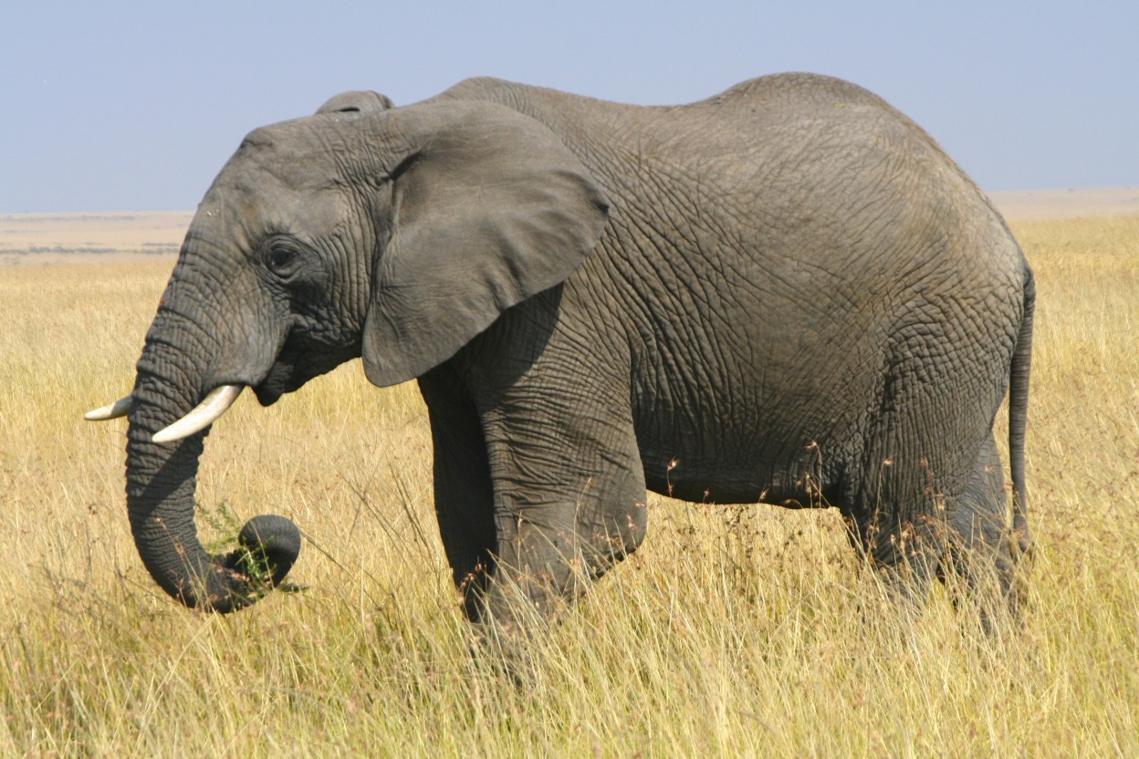
Reliability sample
Weigth ?
1 – 2000 kg
2 - 3000 kg
Not reliable

Slide 48
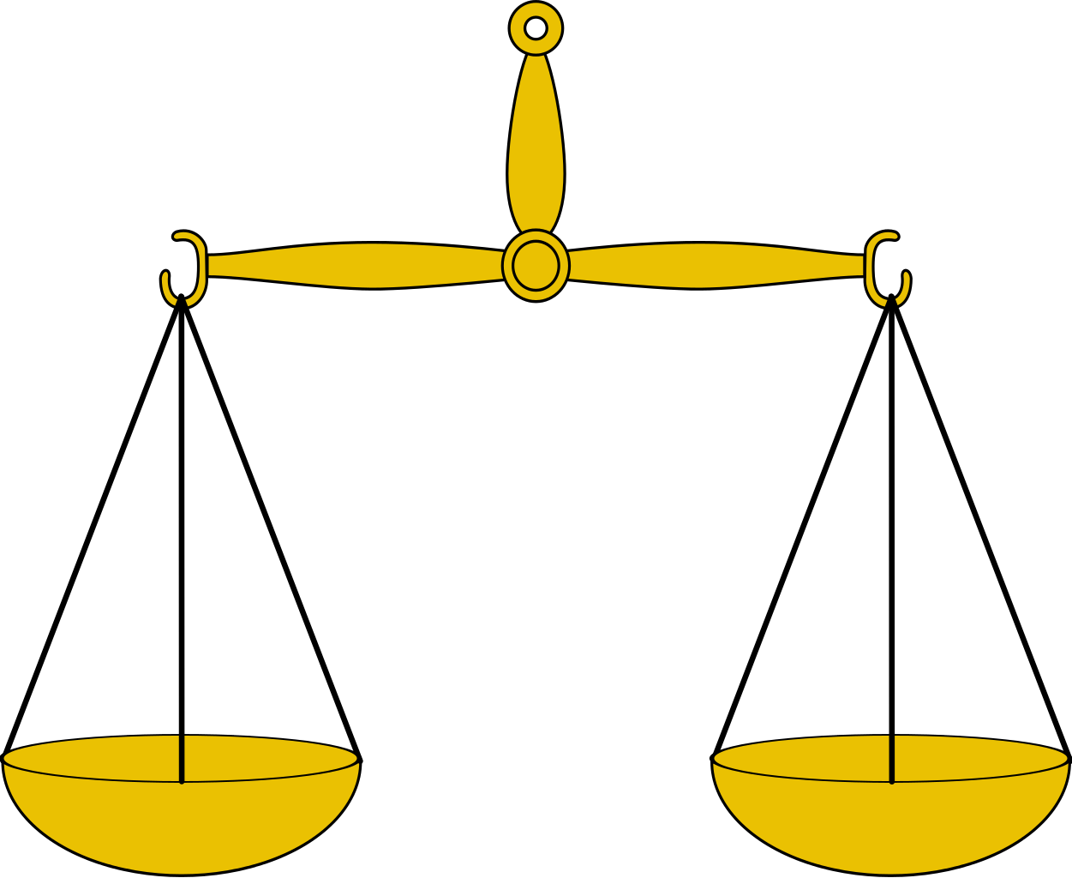
Reliability sample
1 – 3000 kg
2 - 3000 kg
Not reliable
Questions to be considered…

Slide 49
Validity in measurement
Content validity represents the degree to which an instrument measures a specific content area.
Mathematical test: addtition …
Logical validity
Item validity reflects whether the items of the instrument or test actually represent measurement in the intended content area.
“ Does a question about the Library of Congress classification scheme in fact measure a student’s understanding of how materials are arranged in a library’s collection?”

Slide 50
Validity and reliability
Reliable, not valid
Valid, not reliable
Reliable, Valid

Slide 51
Instructor’s contact information
Juanjo Boté Twitter/Instagram/IGTV @jjbotev juanjo.botev@ub.edu

