Slide 1
Organization of information: an introduction
EINFOSE
http://einfose.ffos.hr/
Polona VilAR / AAIS

Slide 2
Warming up…
Try to remember your last library visit. ☺
How are things (books, other materials) organized there?
How can we find something?
Try to remember the last time you used some database (such as library catalogue, online music/film collection, Wikipedia… NOT google)
Were you searching for something? What? How? How successfully?

Slide 3
Organization, organize
Organization = purposeful setting up of order and structure
Why we organize?
To understand the world around us
To save time
To easily find, give, transfer, use things/information
Organization of collections in libraries, museums, bookstores, etc.
Enables to form collections of results of human creation for various purposes: posterity, public, selling, own use, etc.
Physical / digital

Slide 4
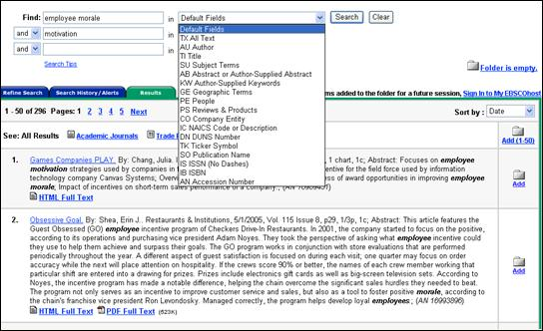
Information sources
Primary/Secondary/Terciary
Purpose
How detailed is the content
Bibliographic/factographic
Giving information on the form/content
Physical/Digital
How were they created
Their characteristics influence how they are stored/accessed/used
Web: available online, often public, problem of reliability, quality
Social: stemming from social contacts, group work etc., difficult to record&describe
Transactional: stemming from various transactions (people <-> people, people <-> machines, machines <-> machines), difficult to record & describe

Slide 5
Building a collection
Choice
Identification, evaluation, choice of resources (defined by the nature of the collection)
Organization
Setting up principles / rules which will govern the arrangement of the resources
Setting up interactions with resources
Setting up and implementing tools, functions, services to enable access and interaction with resources
Maintenance
Storing, managing, preservation of resources

Slide 6
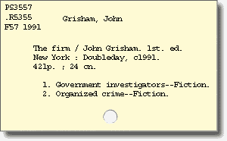
Organization of information
Also: Knowledge organization
For successful transfer of information it must be in such a form that users can read, understand, and of course find it → information must be organized!
Practice of information organizaton changes with technology, but intellectual foundations stay relatively unchanged
A process of describing a resource which creates a surrogate of the actual resource
Bibliographical description/record / metadata
A description of a resource in a collection is often called a metadata description
http://www.usg.edu/galileo/skills/unit04/primer04_04.phtml

Slide 7
Fundamental concepts
Controlled vocabulary
List of terms to be used for indexing
Controlls the variability / redundancy of natural language, helps maintain consistency
Examples: keyword lists, subject headings, classifications, thesauri, authorities, taxonomies
Opposition: uncontrolled list (full-text, tags, …)
Solution: both
Facet analysis
Division of concepts within a subject domain into consistent sections – facets
This principle helps make classifications, thesauri etc.
Example: HISTORIC BUILDINGS
PURPOSE: house, school, church,…
STYLE: Gothic, classical, …
AGE: Victorian, medieval, …
CONSTRUCTION: stone, brick, timber, …

Slide 8
Tools for information organization (1)
Terminologies (term lists)
Lists of terms, usually used in a discipline
Dictionaries / glossaries, subject heading slists, thesauri, taxonomies
Metadata →
‚data about data‘; „structured information that describes, explains, locates, or otherwise makes it easier to retrieve, use, or manage an information resource“ (NISO, 2004)
Resource description and cataloguing
Provision of descriptive metadata on the physical form of a document
Functions:
Traditional (Cutter): finding resources, showing available resources, choosing the best resource
Today (FRBR): find, identify, select, and obtain

Slide 9
Tools for information organization (2)
Subject description
Provision of descriptive metadata on the content (aboutness)
Ontologies
Systematic vocabularies: classification and taxonomy
Systems trying to show the hierarchical relationships between concepts
Alphabetic vocabularies: subject headings lists, thesauri
Terms arranged in alphabetical order
Abstracting
Abstract: „a brief but accurate representation of a content of a document“ (Lancaster, 2003)
Indexing and tagging
Index: „a systematic arrangement of entries designed to enable users to locate information in a document or in a collection of documents“ (Bawden&Robinson, 2012)
Physical/digital

Slide 10
Organization of information
Precondition for effective information organization: good description / good metadata
Must contain enough information to enable finding, identification, selection and acquisition of a resource, and exploration of a collection
Must be based on knowing:
The collection/resources: characteristics, purpose
Needs of users for which the collection is aimed
Standards linked with metadata, which define the structure and content of the records, use of terminology, thus enabling consistency, access, interoperability, reliability

Slide 11
Descriptions / metadata
MAIN QUESTIONS:
What kind of description = what metadata will make it easier for the users to use the collection / a resource?
Who are the expected users?
USERS of information sources i.e. TARGET AUDIENCE (certain groups of people, general population, computers, persons who describe) have an important influence on
What is being described (which elements, information) and
How it is being described (format of the description, values of elements)

Slide 12
Standards related to descriptions (1)
Formal documents; their purpose is to set up unified criteria, methods, processes, practices
Created for specific purposes:
Formation, creation, implementation of data structures
Defining the content of cataloguing and guiding the practice of metadata creation
Defining the values of data (so called information organization systems, such as thesauri, controlled vocabularies, classifications, authority lists)
Support in effective and consistent data exchange
Some standards can include more than one purpose.

Slide 13
Standards related to descriptions (2)
TYPES/EXAMPLES OF STANDARDS ACCORDING TO PURPOSE
MARC21
Dublin Core CDWA EAD
VRA Core …
RDA AACR2 PPIAK
CCO …
Standards defining structure of data
Standards defining content of cataloguing
ISO2709(MARC)
XML HTML5
RDF
…
LCSH
DDC
UDC
AAT TGN …
Standards for
data exchange
Standards defining data values
adapted from Zeng, M.l. & Qin, J. (2016, p.23)

Slide 14
Types of metadata
Descriptive
Administrative
Technical
Preservation
Rights
Structural
Markup languages
For finding or understanding a resource
For decoding and rendering files
Long-term management of files
Intellectual property rights attached to a document
Relationships of parts of resources to one another
Integrates metadata and tags for other structural or semantic features within content
adapted from Riley, 2017, p. 6

Slide 15
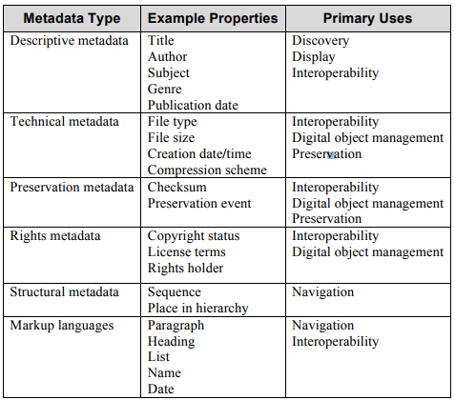
Riley, 2017, p. 7

Slide 16
Example(s)
100 $a Grisham, John,
$d 1955-
245 $a The Firm
260 $a New York :
$b Doubleday,
$c c1991.
300 $a 421 p. $c 24 cm
600 $a Government investigators
$v Fiction
…
<dc:creator>Grisham, John, 1955- </>
<dc:title>The Firm</>
<dc:publisher>Doubleday</>
<dc:date>1991</>
<dc:format>421 p.</>
<dc:format>24 cm</>
<dc:subject>Government investigators--Fiction</>
<dc:subject>Organized crime--Fiction</>
…

Slide 17
Contexts of describing
FUNCTIONAL REQUIREMENTS define:
The users of a collection
The context of the collection
Content of the collection
ALSO: In spite of standards, describing can be somewhat biased – influenced by the description creator
His/her motives, expertise,…
His/her view of how best to serve the needs of users (end users, information intermediaries who search for others)

Slide 18
to what extent
LIMITATIONS
homogene/
heterogene
when
size
NATURE OF COLLEC-TION
MANAGEMENT
lifespan
DOMAIN AND RESOURCE CHARACT.
who, how
purpose
type of use
USERS
numbers
NATURE OF RESOUR-CES
lifespan
characte-ristics
homogene/
heterogene
characte-ristics
unit of description
Slide: Merčun, 2016

Slide 19
Information technologies
Usually associated with computers and networks
Wider sense: any tools and machines assisting processes below
Is a clay tablet IT?
Today mainly:
Computers
Networks
Mobile and pervasive technologies
Applications of technologies: creation, dissemination, sharing, organization&retrieval, preservation
Human-computer interaction

Slide 20
Orientation questions
Why do we need information organization?
What is information organization?
What are fundamental concepts of information organization?
Which tools are used in information organization? Describe them.
What is metadata?
What is good metadata?
What are metadata standards? What types are there?
Types of metadata, examples, aims and primary uses.
What are functional requirements?
What types of information sources are there?
Which information processes are assisted by information technologies?

Slide 21
Contact
Polona.Vilar@ff.uni-lj.si

