Slide 1
The Search Process
EINFOSE
http://einfose.ffos.hr/
Andreu Sulé | PIS&R

Slide 2
Phases of the search process
Know what is needed
Where to search
How to search
Evaluate the results

Slide 3
Know what is needed
Clearly identify the problem to be solved
Subject analysis
Situational analysis
List of terms for the search

Slide 4
1. Clearly identify the problem to be solved
Main purpose > To find the best information to solve the problem.
Avoid irrelevant information (noise)
Avoid the lack of relevant information (silence)
Analysis of the problem
Specify the scope of the information we need (subject)
Determine the characteristics that the information must have (situational)
Example > The case of the Patriot Act.

Slide 5
2. Subject analysis
Generic subject
Specific aspects of the subject
Point of view
Geographic scope
Chronological scope
Related with Where to search + How to search

Slide 6
3. Situational analysis
Related to the situation itself (rel. Where to search + Evaluate results)
Purpose
Level of exhaustivity
Type of resources
Time allowed to find and read the information
Related to the person who has the information need (rel. Evaluate results)
Education level
Knowledge about the subject
Languages that can read
Access to information

Slide 7
4. List of terms for the search
Terms
Synonymous
Equivalents in other languages
English | German | Spanish
Patriot Act
Terrorism | Terrorismus | Terrorismo
Jurisprudence | Jurisprudenz | Jurisprudencia
Libraries | Bibliotheken | Bibliotecas
Library users | Benutzer der Bibliothek | Usuarios de bibliotecas
Information privacy | Datenschutz | Privacidad de la información
Data privacy | Datenprivatsphäre | Privacidad de los datos
Data protection | Datenschutz | Protección de los datos
United States of America | Vereinigte Staaten von Amerika | Estados Unidos de América
USA | USA | EE.UU.

Slide 8
Subject and situational analysis determine
Where to search
How to search
Evaluate the results

Slide 9
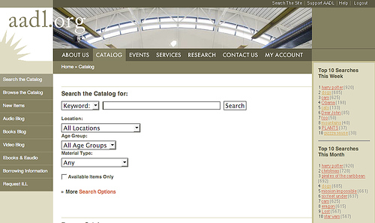
Where to search
Select the appropriate search tools

Slide 10
Where to search
Type of source of information
Primary > direct access to information (Wikipedia, Google Knowledge, …)
Secondary > indirect access to information (Google, library catalogs, data bases, …)
Analysis of sources of information
Authority
Subject specialization
Level of exhaustivity
Type of resources (book, journal, map, video, song…)
Language of resources
Access to information
Chronological scope
Geographical scope

Slide 11
Google
Type of source of information | Secondary
Authority | Google Inc.
Subject specialization | General
Level of exhaustivity | All indexed Web resources
Type of resources | All kind (Web pages, PDF, news, maps…)
Language of resources | All languages
Access to information | Mainly free, open access
Chronological scope | All
Geographical scope | All

Slide 12
PubMed (database)
Type of source of information | Secondary
Authority | United States National Library of Medicine; National Institutes of Health
Subject specialization | Life sciences
Level of exhaustivity | Selective
Type of resources | Mainly articles of journals
Language of resources | Mainly English
Access to information | Open and subscription access
Chronological scope | 1966-
Geographical scope | Mainly USA

Slide 13
How to search
Simple search
Advanced search
Fields search
Boolean operators
Exact phrase
Truncation
Exploratory search

Slide 14
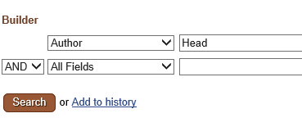
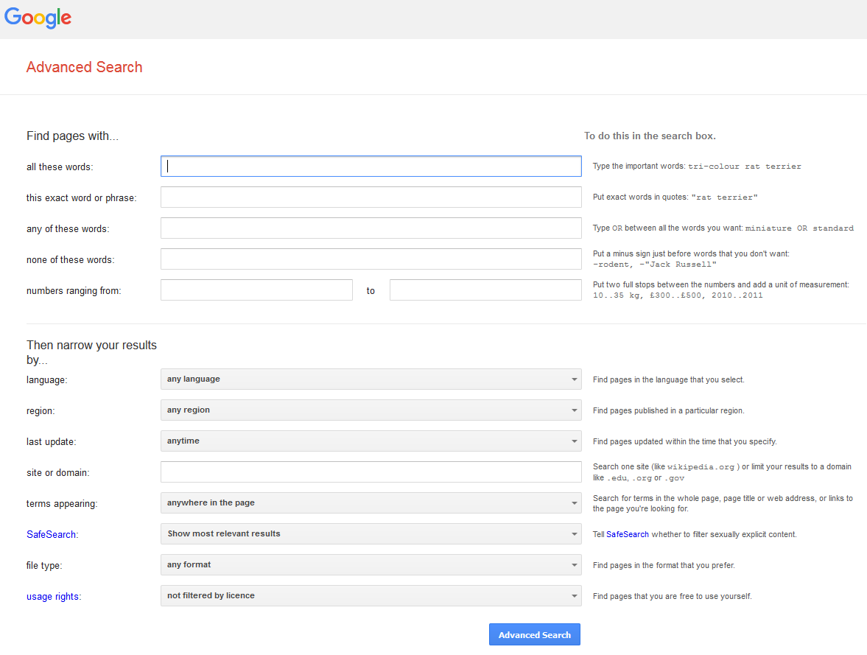
How to search
Each source of information has its own search possibilities

Slide 15
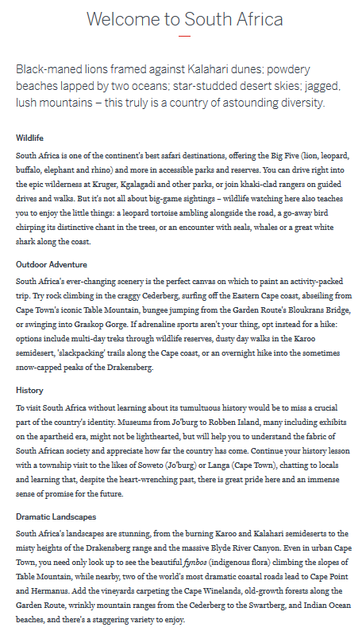
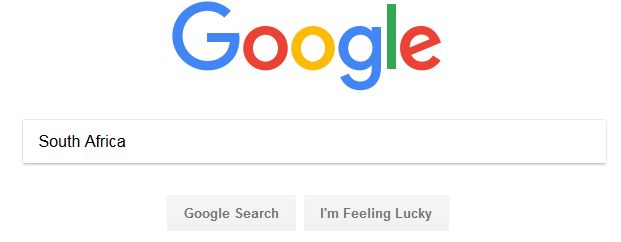
How to search
Simple search
https://www.google.com/
https://www.lonelyplanet.com/south-africa

Slide 16
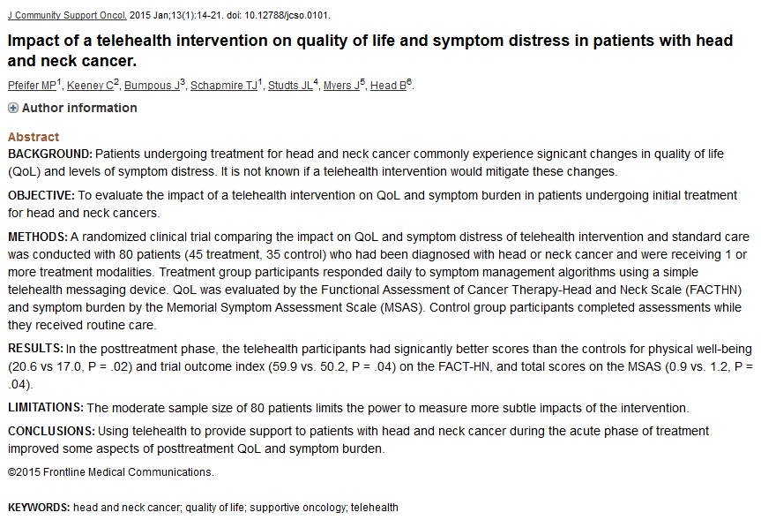
How to search
Simple search
https://www.ncbi.nlm.nih.gov/pubmed/
https://www.ncbi.nlm.nih.gov/pubmed/25839061

Slide 17
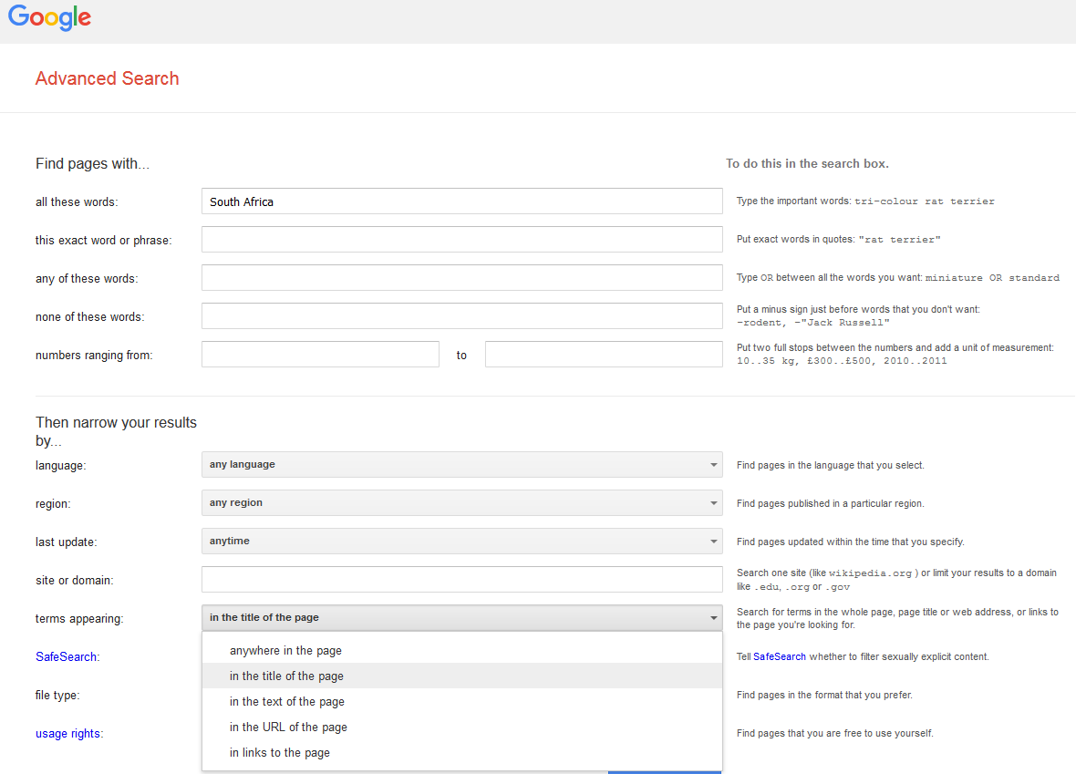
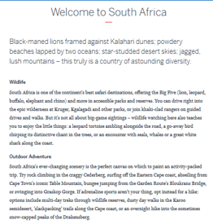
How to search
Advanced search
Narrows the search
Fields search
https://www.lonelyplanet.com/south-africa
https://www.google.com/advanced_search?hl=en-ES&fg=1

Slide 18
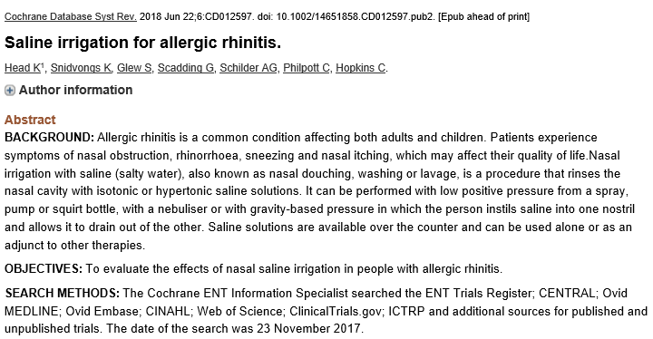
How to search
Advanced search
Narrows the search
Fields search
https://www.ncbi.nlm.nih.gov/pubmed/29932206

Slide 19
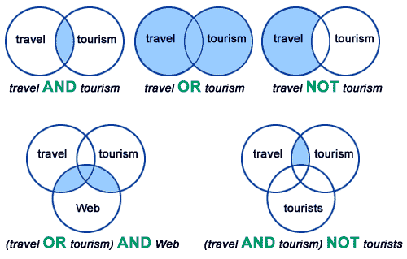
How to search
Boolean operators
Narrows the search
Broadens the search
Parentheses to prioritize Boolean operators
Fields search
Boolean operators. Information Resource Centre Blog.

Slide 20
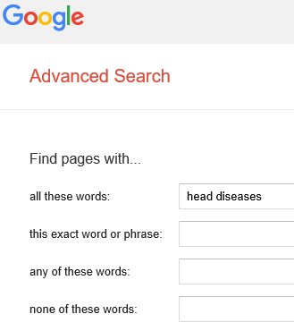
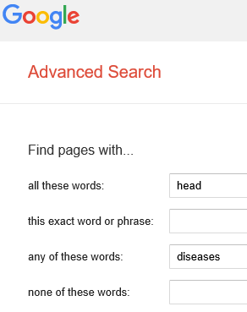
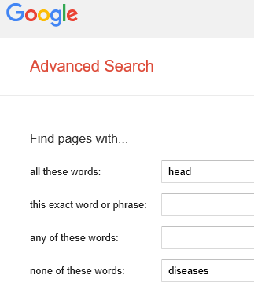
How to search
Boolean operators
AND
OR
NOT

Slide 21
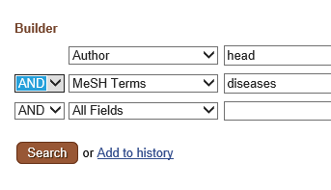
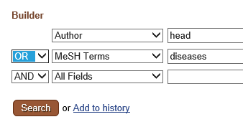
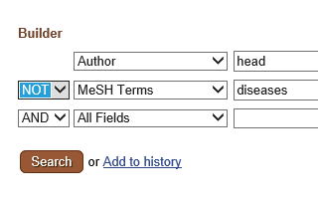
How to search
Boolean operators
AND
OR
NOT

Slide 22
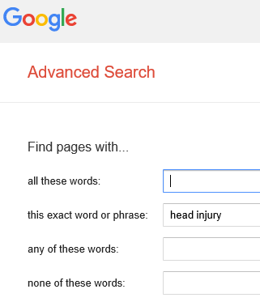
How to search
Exact phrase
Narrows the search

Slide 23
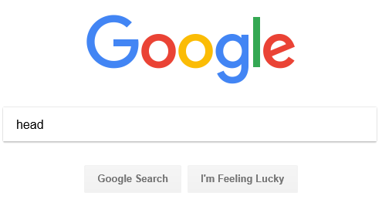
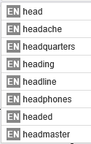
How to search
Truncation
Broadens the search
Automatic truncation

Slide 24
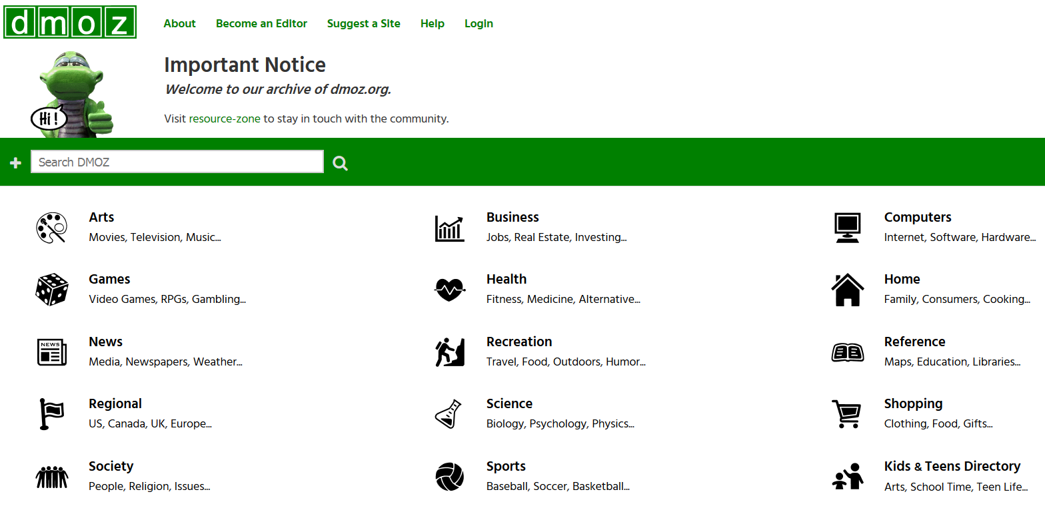
How to search
Exploratory search
Terms hierarchically structured
http://dmoz-odp.org/

Slide 25
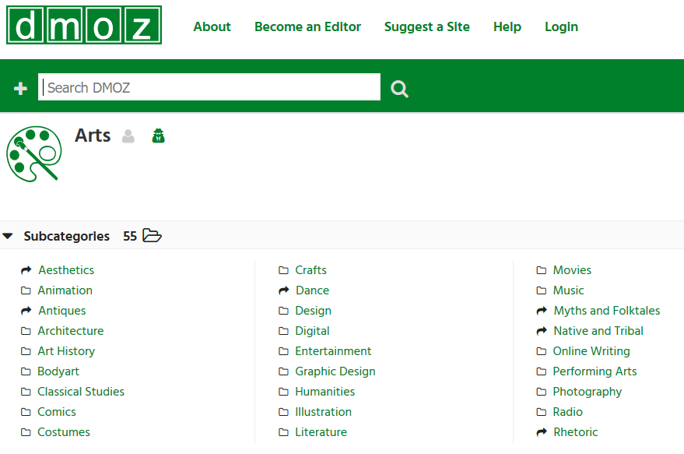
How to search
Exploratory search
Terms hierarchically structured
http://dmoz-odp.org/

Slide 26
How to search
Exploratory search
Terms hierarchically structured
http://dmoz-odp.org/

Slide 27
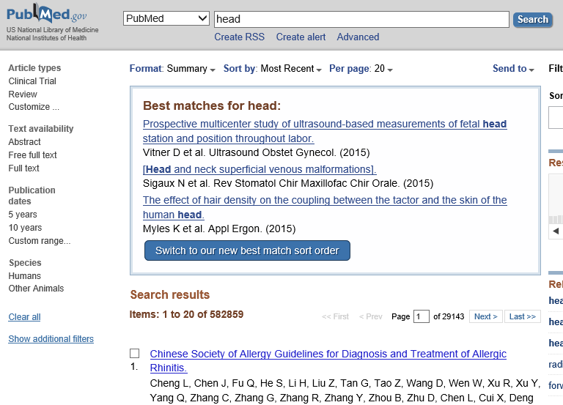
How to search
Exploratory search
Filters
Narrows the search.

Slide 28
Evaluate the results
Objective relevance
Authorship
Content
Updating
Authoritative of the publication
Access
Subjective relevance

Slide 29
Instructor Contact Information
sule@ub.edu

