Slide 1
Evaluation Christian Schlögl University of Graz
EINFOSE
http://einfose.ffos.hr/

Slide 2
Evaluation
4 main parts:
Evaluation – general introduction
Evalution of information services
Evaluation of information retrieval systems

Slide 3
Evaluation Part 1: General introduction

Slide 4
Evaluation: Definition
No uniform/general definition
A systematic, rigorous, and meticulous application of scientific methods to assess the design, implementation, improvement, or outcomes of a program. It is a resource-intensive process … requiring resources such as evaluation expertise, larbor, time and budget. (Wikipedia)
Evaluation is a process, in which an evaluation object is assessed according to previously defined goals using well reasoned criteria. (Balzer)

Slide 5
Evaluation: Characteristics
Evaluation is an assessment which requires that criteria have been determined before.
An evaluation is conducted on the basis of systematically collected data.
Evaluation is performed for a particular goal.
Usually the quality of the evaluation object should be improved.
Normally, it is performed in an organization.
Own professional societies:
American Evaluation Association
DGEval (German Association for Evaluation)

Slide 6
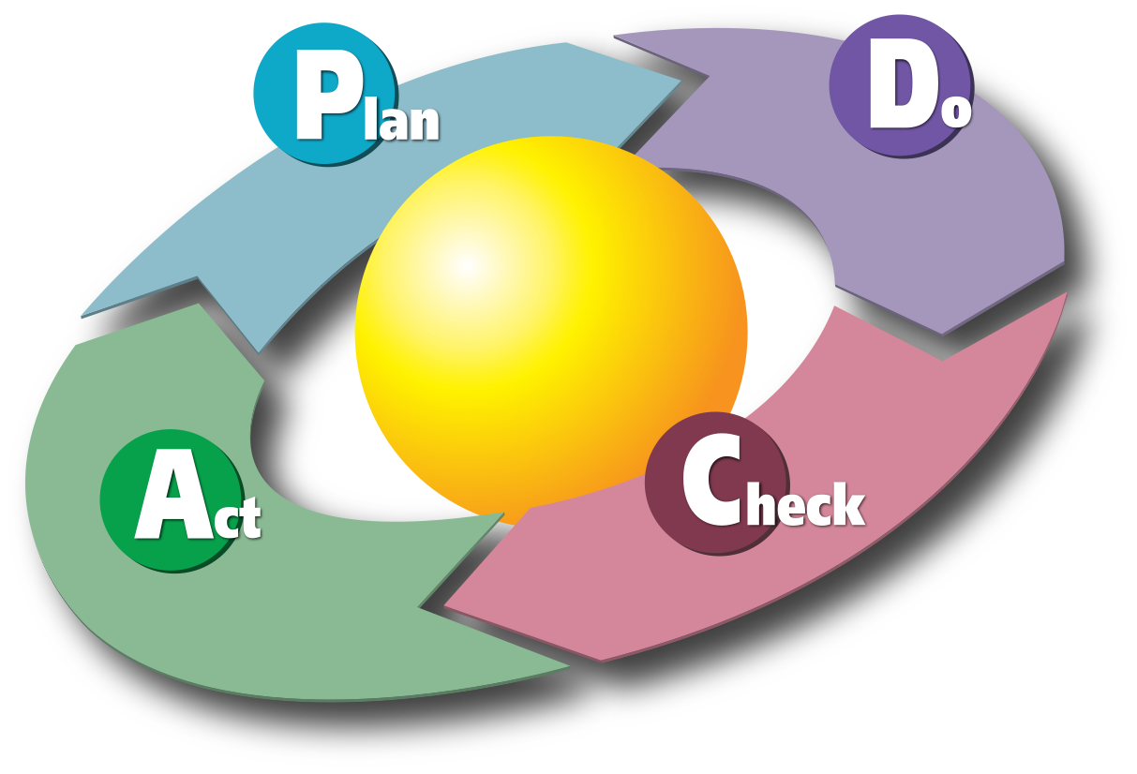
Evaluation: Deming circle/cycle (PDCA circle)
Evaluation

Slide 7
Evaluation: Type of evaluation depending on point of time (purpose)
Formative (constitutive):
Current feedback: e.g. current course evaluation
Summative (concluding):
Usually at the end
Should provide information whether an „acitivity“ should be completed or continued (and what should be improved), e.g. evaluation of the Joint Degree Programme

Slide 8
Evaluation: Type of evaluation depending on origin of evaluators
Internal:
evaluator from inside the organisation in which an evaluation takes place
E.g., university institute is evaluated by vice rector of research
External:
evaluator from outside the organisation
E.g., university institute is evaluated by an independent research evaluation institute which was authorized by the rector

Slide 9
Evaluation: Type of evaluation depending on relation of evaluator towards the evaluation object
Self evaluation:
E.g. an institute is requested by the vice-rector of research to evaluate its research output (itself)
Evaluation object and evaluators are partly identical
Foreign evaluation:
E.g., evaluation of publication output of an institute is analyzed by members of university library
Staff of evaluation object and the evaluator(s) are not identical

Slide 10
Evaluation: Objects of evaluation
Persons
Companies
Organisational units/departments
University libraries
Products
Services
(Software) Programmes
Projects
Processes
…

Slide 11
Evaluation: Place where data are collected
Field study:
Close to reality, however many disturbances
Examples: library, school class, …
Laboratory study
evaluation takes place in a „controlled“ enviroment
No disturbance → better controlability

Slide 12
Evaluation: Data collection
Primary data:
Data are collected for the purpose of evaluation
Methods:
?
?
?
?
Secondary data:
Data were collected for another purpose before and are re-used for the purpose of the evaluation
Sources:
Factual databases
Alread collected data („data librarian“)
Advantages: time and cost saving, often big data quantities
Disadvantages: lower data quality, data not up-to-date

Slide 13
Evaluation: Data collection
Primary data:
Data are collected for the purpose of evaluation
Methods:
Interview
Survey
Content analysis
Observation
Secondary data:
Data were collected for another purpose before and are re-used for the purpose of the evaluation
Sources:
Factual databases
Alread collected data („data librarian“)
Advantages: time and cost saving, often big data quantities
Disadvantages: lower data quality, data not up-to-date

Slide 14
Evaluation: Data analysis 1
Quantitative analyses:
Counting of occurances → statistics
Types of analyses:
Univariate:
Frequency distributions
Mean, median, variance, …
Bivariate:
Correlation and association
Simple regression
Multivariate: complex relations
Multiple regression
Variance analysis
Factor analysis
Cluster analysis

Slide 15
Evaluation: Data analysis 2
Qualitative analyses:
In evaluation object is not well explored (not much pre-knowledge)
If analysis should go into more detail (e.g. exploring motivations and reasons)
Verbal interpretation of collected data
Type of analysis:
Content analysis
Manual/intellectual
Computer-based (e.g., sentiment analysis)

Slide 16
Evaluation: Literature
Wikipedia article on Evaluation. Retrieved from https://en.wikipedia.org/wiki/Evaluation on June 28, 2018.
American Evaluation Association. Guiding Principles for Evaluators. Retrieved from file:///C:/Users/schloegl/AppData/Local/Temp/AEA%20Guiding%20Principles.pdf on June 28, 2018.

Slide 17
Motivation Part 2: Evaluation of Information Services (and Libraries)

Slide 18
Evaluation of Information Services Definition
Information services are supplied by organizations/organizational units performing „information activities“as their main purpose
Information services are demanded by users who have an information need and who want to solve an existing information problem.

Slide 19
Evaluation of Information Services Information services - examples
?
?

Slide 20
Evaluation of Information Services Information services - examples
Providing search for books in an OPAC (library)
Lending books (library)
Answering information-related user inquiries (library)
Providing access to literature databases (library)
Providing access to e-journals (library, e.g. Ebsco)
Providing access to many databases (host)
Performing searches and an analysis of the the searach results to others (information broker)
Providing (direct) access to books in a reading room (library)
Offering social media analyses (marketing research company)
Producing a statistcs database and offering access to it (e.g. Eurostat, Statistics Austria)
Providing a platform to create an online encyclopedia and to search for terms in it (e.g. Wikipedia)
Crawling the web and providing access to it (e.g. Google)
Providing big data analyses (e.g. Competitive Intelligence Department)

Slide 21
Evaluation of Information Services Evaluation of info services - dimensions
Perceived service quality
Perceived information system quality
Objective information service quality
Information user
Information environment

Slide 22
Evaluation of Information Services Perceived service quality
Several methods, among SERVQUAL is one of the best known
Standardized instrument for measuring service quality and finally user satisfaction
Uses a questionnaire, consisting of
22 expection items and
22 perception items (in total 44 questions)
Which make up 5 dimentions:
Reliability: abilitiy to perform the service correctly
Assurance: politeness, if employees convey trust and competence
Tangibles: appearance of staff and facilities
Empathy: empathy and individualyzed care of staff
Responsiveness: willingness to help users and to offer quick assistance

Slide 23
Evaluation of Information Services Perceived service quality
SERVQUAL:
Each item is measured on a 7 point Lickert scale (from „strongly disagree“ (1) to „strongly agree“ (7) both with regards to user expectation and user perception
Service quality = user‘s perception of a given service – user‘s expectation towards a given service
Perceptions > expectations → high service quality
Expectations > perceptions → low service quality

Slide 24
Evaluation of Information Services Perceived system quality
Technical aspects are evaluated, e.g. social media analysis tool
Also here several models, among Technology Acceptance Model is one of the best known
System quality - 2 dimensions
Perceived ease of use
Perceived usefulness
Questionnaires are used, items are measured on a 7 point scale as well (from „extremely likely“ to „extremely unlikely“)
E.g., „My interaction with system Y is clear and understandable“
E.g., „Using system Y would enable me to accomplish tasks more quickly“

Slide 25
Evaluation of Information Services Objective information service quality
Evaluation results are not based on users‘ perceptions but on the basis of more objective methods:
Usability test:
Task-based user testing:
Are the users able to execute the task?
Would a shorter (more efficient) execution have been possible?
Thinking aloud and video recording
Ev. analyzing protocol data

Slide 26
Evaluation of Information Services Information User
Without user research, no serious evaluation of information services is possible
Aspects of information user studies:
Information need: starting point
Information behaviour
Information search behaviour
Information production behaviour
Person-related factors: gender, age, digital native (yes/no), culture

Slide 27
Evaluation of Information Services Information User: excursus search behavior
Results of search engine studies:
Most of the users only consult the first result page / the first ten results
Boolean operators are only used by a small minority of users (many use them wrongly: e.g. „and“)
Phrase search (e.g. „information services“) is extremely seldomly applied
Searches are usually not modified/improved
Only a small proportion of Web searches consists of more than 3 search items

Slide 28
Evaluation of Information Services Information Environment
Users and information services are embedded in contexts:
Cultural influences
Organizational background: faculty library of physics vs. faculty library of philosophy
Market situation: competitors
Time: university library now – 30 years ago
…

Slide 29
Evaluation of Information Services Extent of IS evaluation
Evaluation of particular aspects of information services:
Evaluation of book collection and training
Evaluation of journal collection
Evaluation of opening hours
User study
…
Evaluation of the whole organization promoting a systematic process of assessment:
SCONUL Satisfaction Survey
LibQUAL+

Slide 30
Evaluation of Information Services LibQUAL+
Web based survey tool which was developed on the basis of SERVQUAL
Goals:
Collect and interpret library user feedback systematically over time
Provide libraries with a comparable assessment information from peer institutions → identify best practices
22 core questions which consist of several dimensions of library service quality:
Effectiveness of library staff
Library as a place
„Information control“: ease with which information can be found
„local“ library questions
Demographic details
Since 2000 more than 1350 libraries from 35 countries have participated in LibQUAL+

Slide 31
Evaluation of Information Services Literature
Schumann Laura, Stock Wolfgang G.: The Information Service Evaluation (ISE) Model. In: Webology, Vol. 11, No. 1, 2014, Retrieved from http://www.webology.org/2014/v11n1/a115.pdf June 28th, 2018.
Wikipedia article on Library assessment. Retrieved from https://en.wikipedia.org/wiki/Library_assessment on June 29th, 2018.

Slide 32
Evaluation Part 3: Evaluation of Information Retrieval Systems (IRS)

Slide 33
Evaluation of Information Retrieval Systems (IRS): Introduction
Information retrieval system (IRS): particular kind of an information system
Evaluation of information retrieval systems (IR-S) – 3 (4) dimensions:
IT service quality
Knowledge quality
IT system quality
4. Information retrieval system quality

Slide 34
Evaluation of IRS: Evaluation of IT service quality
Quality of the general services provided by IRS is evaluated:
Speed/response time
User friendliness
etc.
Possible method: SERVQUAL (see above)

Slide 35
Evaluation of IRS: Evaluation of knowledge quality 1
Contents of IRS is evaluated
2 objects of evaluation:
Documentary reference units: e.g. books
Documentary units/surrogates: e.g. bibliographic description of books
Quality of documents of an IRS can vary considerably: Web search engine vs. Web of Science (quality evaluation – only peer reviewed journals/journal articles)

Slide 36
Evaluation of IRS: Evaluation of knowledge quality 2
Evaluation of documentary units/surrogates – dimensions:
Knowledge management system: existing classification system, thesaurus or nomenclature; and their quality
Quality of indexing:
Indexing depth
Indexing consistency
Informativeness of summaries
Update speed: entry of new documents

Slide 37
Evaluation of IRS: Evaluation of IRS quality 1
IRS is a particular kind of an IT system → it makes sense to perform an evaluation at a more detailed level
2 dimensions of IRS:
IRS functions: functions provided for searching and retrieving information (usefulness)
Depending on the purpose of an IRS: big differences in the extent of provided functionality (Google vs. Ebsco host)
IRS usability: Is an IRS intuitively easy to use?

Slide 38
Evaluation of IRS: Evaluation of IRS quality 2
List of functions expected from a professional IRS (1):
Selection of databases:
Database index?
Search in more databases in parallel?
Looking for search arguments:
Browsing in a dictionary?
Synonym dictionary?
Presentation of knowledge organisation system:
verbal
graphic

Slide 39
Evaluation of IRS: Evaluation of IRS quality 3
List of functions expected from a professional IRS (2):
3. Display and output:
Sorting possibilities of search results?
Marking/filtering of surrogates for sorting and output?
Output of surrogates in different formats (CSV, XML, various bibliographic database formats, etc.)?
Link to digital version or document delivery service?
4. Push services:
Creation and administration of search profiles?
Regular delivering of (new) search results?
5. Informetric analyses:
Rankings
Semantic networks and/or information flow graphs

Slide 40
Evaluation of IRS: Evaluation of IRS quality 4
Evaluation of IRS quality/effectiveness - indicators:
Several IRS effectiveness measures in literature – most well known:
Recall: completness of search results (hit list) – how many of all (existing) relevant documents were found?
Precision: exactliness of search results (hit list) – how many of all found documents are relevant?
Fallout: probability at which a non-relevant document is found

Slide 41
Evaluation of IRS: Evaluation of IRS quality 5
 | Relevant | Non-relevant
Retrieved docs | A | B | A+B: retrieved docs in a search
Not retrieved docs | C | D
 | A+C: all relevant docs in an IR-S | B+D: all non- relevant docs in an IR-S | A+B+C+D: no. of docs in an IR-S
Recall = $\frac{ A }{A+C}$
Precision = $\frac{ A }{A+B}$
Fallout = $\frac{ B }{B+D}$

Slide 42
Evaluation of IRS: Evaluation of IRS quality 6
Example:
A database comprises 136 documents in total out of which 20 are relevant (and 116 are not-relevant) with regards to a particular search.
The search delivers 12 documents out of which 8 documents are relevant.
 | Relevant | Non-relevant
Retrieved docs | 8 | 4 | 12
Not retrieved docs | 12 | 112 | 124
 | 20 | 116 | 136
Recall = $\frac{ A }{A+C}$ = 8/20 = 0.4
Precision = $\frac{ A }{A+B}$ = 8/12 = 0.67
Fallout = $\frac{ B }{B+D}$ = 4/116 = 0.034

Slide 43
Evaluation of IRS: Evaluation of IRS quality 7
There is a tradeoff between recall and precision:
A high precision is usually related with ? recall.
A higher recall is usually related with ? precision.
It depends on the kind of search task which indicator is more important:
Search for literature for Phd thesis?
Search for some literature for a course?
Patent search (Does a certain patent for a certain technology – in which a company wants to invest for research and development – already exist)?
A „good search system“ should find as many relevant documents as possible (high recall) and at the same time comprise as little non-relevant documents as possible (high precision).

Slide 44
Evaluation of IRS: Evaluation of IRS quality 8
A „good search system“ should find as many relevant documents as possible and at the same time comprise as little non-relevant documents as possible.
Recall
e.g. WoS
e.g. GS
Precision

Slide 45
Evaluation of IRS: Evaluation of IRS quality 9
Problems with recall and precision 1:
Recall: usually it is not known how many relevant documents are covered by an IRS, e.g. in Google → relative recall:
consideration only of the e.g. top-500 most relevant documents
if different search engines are evaluated with the same search: new relevant documents (found by another search engine) are added to the relevant and not-found documents
Relevance of a document: either TRUE or FALSE, relevance judgments are highly subjective

Slide 46
Evaluation of IRS: Evaluation of IRS quality 10
Problems with recall and precision 2:
Evaluation of retrieval systems which sort the hit list on the basis of a relevance ranking → mean average precision (MAP)
Determination of a threshold value up to which the search results are analyzed (for instance, first 10 search results in Google searches)
Calculation of average precision for a specific query
Calculation of average precision for all queries

Slide 47
Evaluation of IRS: Evaluation of IRS quality 11
MAP (mean average precision):
$MAP=\frac{1}{n}\sum_{i=1}^{n}{ \frac{1}{m}\sum_{j=1}^{m}{Prec ({Rij)}_{}}}$
n…number of queries
m… number of relevant results

Slide 48
Evaluation of IRS: Evaluation of IRS quality 12
MAP (mean average precision) - example:
Results for Query 1 (5 relevant documents):
Rank | 1 | 2 | 3 | 4 | 5 | 6 | 7 | 8 | 9 | 10
relevant | yes | no | yes | no | no | yes | no | no | yes | yes
Prec (Query 1) | 1.0 | 0.5 | 0.67 | 0.5 | 0.4 | 0.5 | 0.43 | 0.38 | 0.44 | 0.5
Average precision: (1.0 + 0.67 + 0.5 + 0.44 + 0.5) / 5 = 0.62
Results for Query 2 (3 relevant documents):
Rank | 1 | 2 | 3 | 4 | 5 | 6 | 7 | 8 | 9 | 10
relevant | no | yes | no | no | yes | no | yes | no | no | no
Prec (Query 2) | 0 | 0.5 | 0.33 | 0.25 | 0.4 | 0.33 | 0.43 | 0.38 | 0.33 | 0.3
Average precision: (0.5 + 0.4 + 0.43) / 3 = 0.44
Mean average precision: (0.62 + 0.44) / 2 = 0.53

Slide 49
Evaluation of IRS: Literature
Stock W.G., Stock M.: Handbook of Information Science, Chapter H.4: Evaluation of Retrieval Systems (pp. 481-497), Berlin: deGruyter Saur, 2013.
Precision and Recall. Wikipedia article. Retrieved from https://en.wikipedia.org/wiki/Precision_and_recall on August 10th, 2017.

