Slide 1
Users, information needs and information behaviour
EINFOSE
http://einfose.ffos.hr/
Polona Vilar / PIS&R

Slide 2
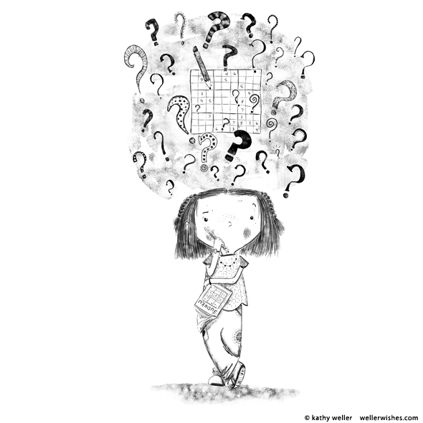
People need information
Mainly to seek answers, solutions etc.
Information needs → motivators for information seeking
Problems with definition
Not a basic human need: it is inspired by other motives (to eat, to have shelter, etc.)
Multidimensional: linked to other human gratifications besides solving a specific problem
Influenced by many factors: experience, situation, system etc.

Slide 3
Problems with information needs
Difficult to observe
observation is problematic, because information needs exist only in
the heads of individuals and must be described
often we actually study demands = what users demand from librarians, systems
Easier to assess, measure, count
Wilson (1981, 1997): researchers mostly study information behaviour not information needs
Nicholas (2000): Key to understanding information needs lies in understanding of problems and situations in which they arise
→ Important:
Contact with users
User research

Slide 4
Information needs - wants - demands
Users don‘t always know what they really need:
„Do you have any books on human beings?“
„I need Gutenberg Bible on a CD.“
needs – internally experienced; necessity, sometimes moral obligation
wants – what we think we need, externally expressed
demands – expressed
Users sometimes don‘t know that they need something:
dormant (= ‚sleeping‘) information needs
expressed inf. needs
Actual needs can stay unexpressed if users see them as unrealistic.

Slide 5
Information behaviour
Individuals are motivated to find information to satisfy their (information) needs. (Wilson, 2005)
information needs information behaviour
Information behaviour (Bates, 2010)
the many ways in which human beings interact with information, in particular the ways in which people seek and utilize information
a subdiscipline [of library/information science] that engages in a wide range of types of research conducted in order to understand the human relationship to information.
Notes:
Bates (2010, p. 2381) as "the many ways in which human beings interact with information, in particular the ways in which people seek and utilize information .. [and also] .. a subdiscipline [of library/information science] that engages in a wide range of types of research conducted in order to understand the human relationship to information".

Slide 6
Nested model (Wilson, 1999)
All human behaviour in relation to sources and channels of information:
active and passive information seeking
other forms of purposeful or nonpurposeful behaviour (such as scanning or serendipity)
other forms of conscious behaviour which do not include seeking (such as active avoiding of information)
information use

Slide 7
Purposeful/unpurposeful
Purposeful directed searching
Consequence of a clear purpose, goal
In books, libraries, inf. systems, on internet etc.
Most researched
Browsing, scanning
Looking for information without / with little purpose
In books, libraries, inf. systems, on internet etc.
Gaining research attention (no more only for ‚dummies‘ )
→ Serendipity
when the user finds something without being aware he/she needed it

Slide 8
Relevance, pertinence, salience /1
Relevance
Aboutness, topicality
relevant = on the right topic.
Pertinence
Relevance based on knowledge and goals of the user, not only on logical matching of terms – subjective view
Situational, psychological relevance = usefulness in relation to the inf. need
Belkin, Vickery (1985): Relevance – answer to a question; pertinence – answer to the information need.
Most users want this.

Slide 9
Relevance, pertinence, salience /2
Salience
Vivid, noticeable, obvious, unusual, etreme, intensive,
colourful, vivid, sudden – stands out
Affects attention, remembering, recall
Problems:
Salient is not necessarily relevant or pertinent
Relevant/pertinent can go unnoticed if not salient

Slide 10
Other related concepts
Selective exposure
More information isn’t always better and desirable
Sometimes (often) information doesn‘t come where it is intended.
Reasons: obstacles, diverting attention, conditions in inf. process
3 aspects:
Selective exposure, avoiding information
Knowledge gaps, information poverty
Information overload & anxiety
Entertainment (activity designed to delight)
Is it different from „serious” information needs? (when studying IB / providing information)

Slide 11
Collaborative information behaviour (Ford, 2015, ch. 5)
What it means, contexts
Collaboration to achieve higer quality goals, easier work, division of labour, …
Common goal, common benefit
Complex task, extra cognitive load
Needed expertise of multiple individuals
Difficult, demanding (in terms of time, work, coordination etc.)
Not necessarily succesful
Types
Co-ordinated, co-operative, co-constructive
Characteristics (why different from infividual inf. behaviour)
Triggers
Unexplored areas

Slide 12
Some relevant theories /1 (Case, 2016, pp. 174-192)
Zipf principle of least effort
“Indivisual will use a series of activities that include the use of probably the least average effort of his/her work.“ = least effort
Searchers minimize their effort in searching, even if it means that they have to accept lower quality information or less information.
Use & gratification and Game & fun
People actively participate in exposure to various media, this being related to fulfilment of their needs.
People treat the ‘input’ of fun and information in relation to satisfying their emotionlal needs. (Stephenson, 1967)
Pleasure/pain: People look for pleasure and avoid ‚pain‘, but also connect these two
What is pleasant?
Use: mass media

Slide 13
Some relevant theories /2
Sense-making and Uncertainty reduction
Information is not something outside human activity – they are created (by individuals or groups) in a certain space/time/context:
‘internal’ creation of information to understand the world, predict things etc.
information to reduce uncertainty
pragmatic solving of problems

Slide 14
Who are users of library and information services, information systems, Internet, ICT?
In general:
Individuals and organizations with certain needs for:
Information, education, culture, entertainment
Typologies are many and varied
Some look at age, context, demographics, experience, role etc.
Others look at individual characteristics influencing behaviour → inf. styles
Others divide actual users (= already here) users and potential users (= still to come)
Special needs

Slide 15
Age
Children (up to 6 years, children to 12 years; preschool, school)
Teenagers (13-19)
Young adults (senior primary school, middle school, students, employed young, unemployed)
Adults (interests)
Elderly (persons in 3rd age) (older employed, retired, unemployed)
Age not an absolute category → role, experience, context etc.
Student/teacher; engineer/manager; child-good reader/child-poor reader
An individual – a different user type in different contexts

Slide 16
Special needs
Visually impaired persons
Deaf or hearing impaired persons
Persons with reading difficulties
‚Print disabled‘
Persons with physical disabilities
Cognitively disabled persons
People in long-term care facilities (hospital patients, prisoners, elderly in long-term care facilities, house-bound people)
People in special circumstances (illiterate, socially-economically deprived, retired, unemployed)
Multicultural communities
→ Adaptation of services, materials, premises etc.

Slide 17
Why do we need to know user types?
Depending on user types librarians / information experts:
Become aware of the rights of all (not only on the expressed needs)
Better understand the needs of actual users
Know who to expect, who to attract and how
Perform their activities and services
Plan and design services, systems
How do we find out? → Research, contact with users,
education & training

Slide 18
Orientation questions
What are information needs?
What problems do we have when dealing with information needs?
Define information behaviour.
What concepts are related to information behaviour? Explain them.
Explain the relation of libraries and information services to intellectual freedom.
Who are users of library and information services, information systems, Internet, ICT? Give some examples.
Why do we need to know user types?

Slide 19
Instructor Contact Information
Polona.Vilar@ff.uni-lj.si

