Slide 1
Sodelovalno iskanje
EINFOSE
http://einfose.ffos.hr/
Stefanie Elbeshausen| PIS&R

Slide 2
Iskanje informacij
Posamezniki
Uporabniško orientirane raziskave
Collaborative Information Seeking (CIS)
Značilnosti
Systemi
Vrednotenje in raziskovanje
Zaključek
Literatura
Notes:
Retrospect on idividual IS and user oriented research ➔ you already heared about it in the previous IS&R-sessions

Slide 3
Iskanje informacij
Notes:
We already heared a lot abot the information seeking or the search process yesterday

Slide 4
Definicija – iskanje informacij
Proces v katerega se ljudje podajo namenoma, da bi spremenili stanje svojega znanja (Marchionini, 1995)
Zaveden napor pridobiti informacije kot odgovor na potrebo ali luknjo v znanju (Case, 2002)
Notes:
Some defintions for individual information seeking (maybe heared before in the user behaviour lecture?)
What alle those definitions have in common is that humans start the process for sseking information when they figure out that they need more information to be able to interact with their invronment.
Some examples on the next slide …

Slide 5
Iskanje informacij
Proces pridobivanja informacij za zapolnitev vrzeli v znanju
Za odločanje
Da se poučimo o nečem
Da pridobimo odgovor na vprašanje
Povečati znanje o nečem
Da zadovoljimo druge potrebe
Notes:
Learn about somethinh ➔ e.g. when did dinosaurs extinct?
Question: wehn did they extinct? 66 million years ago
Need to answer a question ➔ what kind of dinosaur is that?
Triceratops
Need to increase own knowledge about a subject ➔ e.g. just the non-avian dinosaurs extinct – others are still alive in form of birds
The discovery that birds are a type of dinosaur showed that dinosaurs in general are not, in fact, extinct as is commonly stated.^{[174]} However, all non-avian dinosaurs as well as many groups of birds did suddenly become extinct approximately 66 million years ago.

Slide 6
Glavno vprašanje
Kaj se zares dogaja, ko se lotimo iskanja informacij o nečem?
Notes:
In everyday life we really do not care – we just go on doing it – but as professionals we have to understand the process in order to deal with it
The question has many sub-questions such as:
in relation to what are people seeking information? ➔ what is the subject …
how is information seeking (as a broader process)
related to information search (as a narrower process)?
…

Slide 7
Iskanje informacij na podlagi nalog
Naloge izhajajo iz zasebnega ali delovnega konteksta
Npr.:
Najti literaturo o sodobnih dognanjih na nekem področju
Najti hotel v Gradcu
Običajno dolgoročni proces v več seansah
Strukturiranje ciljev na visoki ravni v podnaloge
Podpora sistema bi morala upoštevati naloge
Notes:
Information seeking is usually researched as a task-based process
Tasks can be private – for example find a hotel in Berlin, searching for a certain movie ….
Or work-task related – for example literature search to develop a state of the art (students, scientists) or finding information on a certain diseas to help a sick person (in medicine, doctors …)
It is sually a long-term process and information seeking is necessary during different steps of the task. The sseking process is again devided into different sub-tasks and of course systems should support the user during the process and the process steps
On the next slide you find an example for a model which can be uses as a base to develop (professional) information seeking systems

Slide 8
Uporabniško orientirano raziskovanje
Uporabniški vidiki
Razlike
Znanje o domeni
Znanje o iskanju
Pričakovanja
Relevantnost
Kriteriji za relevantnost
Relevantnost: odvisna od konteksta in dinamična
Notes:
Remember what you heared yesterday ➔ the search process (and evaluation of results) is releted to the person who has the information need
Means in user oriented research we have to keep in mind that users have individual differences (for instance search experience or domain knowledge), that they have different expectations regading the search outcomes, systems and so on
that also means relevance is subjective: depending on the context we judge the relevance of certain information, i.e. the information when the train to Berlin leaves is relevant for me if I want to go to Berlin. If I plan to go to Vienna (or to stay in Graz) it is useless. And relevance is dynamic: the timetable for the trains to Berlin maybe relevant today – but tomorrow I may have other plans (staying in Berlin or travelling to New York).
And also when carrying out user oriented research we have to keep in mind that information retrieval is a process of problem solving (I have a certain problem and need certain informatio to solve it) so cognitive psychology plays an important role what happens mentally? Which mental activities are involved and so on

Slide 9
Razlike med uporabniki
Izkušnje
Sistem
Iskalne strategije
Domena
Motivacija
Kontekst
Viri (Čas, denar, …)
Sistemi, ki so na voljo
Okolje, socialna situacija, ...
Notes:
In the context of CIS on major aspect are user differences
And when we make research in info seeking (or collaborative info seeking) user differences may adress experices of user, fo isntance with search systems, the search startgeies they carry out which vary based on for instance if they are experts and carry out complex searches every day
And further the experience with the certain domain – are they domain experts or domain novices ?
And of course the motivation is important – am I really interested in solving the problkem and intrisically motivated or is it something I have to do and it is rather boring to carry out the certain search?
In addition the context of search is highly relevant: the resources for the search … time and money for instance (why money? Because information is not always available for free), the systems which are available and the environement or social situation (maybe there are restrictions and we don not have access to certain information and so on

Slide 10
Sodelovalno iskanje
CIS
Notes:
And that leads us to collaborative information seeking so information seeking which involves different users and accordingly a variety of user differences we have to keep in mind during research and system development

Slide 11
CIS - Definicija
CIS ➔ Proces iskanja informacij, ki je …
Eksplicitno definiran med udeleženci
Nameren
Interaktiven
V dobrobit vsem
Orientiran k nalogam
Notes:
… and should lead to a benefit in the results: the whole is more than the sum of all
CIS is different form other concept such as socila search
Social search kind of an umbrella term for different aspects of searching together
i.e. amazon ➔ buying a book and getting recommandations based on other users buyings is NOT collaborative search because it is not for instcance explicit and intentional

Slide 12
Od enega uporabnika k več uporabnikom
Različne domene
Različno znanje
Različna strokovnost
Različno ozadje
Različen družbeni status
…
… stvari ne bodo lažje!

Slide 13
Definicija: 5C-jev
Shah (2012)
Notes:
Aspects of social interaction
The outer circle of collaboration involves other concepts of social interaction
➔ In sum: collaboration is a process which involves a variety of social interaction and it is costly to plan this process
Communication. process of sending or exchanging information
one of the core requirements for carrying out collaboration
Contribution. an informal relationship by which individuals help each
other in achieving their personal goals
e.g. I have some books which I don’t need anymore and give them to the library so other people can use them
Coordination. process of connecting different agents together for a harmonious
action. E.g. coordinate lessons of teachers at the summer school for a harmonious time table
Cooperation. relationship in which different agents with similar interests
take part ➔ When cooperating, people perform together (co-operate) while working on selfish yet common goals. ➔ e.g. a school class in which students collaborate but the teacher cooperates to support them
➔ an active session of interaction in which both the parties worked together to solve a problem.
Collaboration.
When collaborating, people work together (co-labor) on a single shared goal.
In contrast to cooperation, collaboration
involves creating a solution that is more than merely the sum of each
party’s contribution. E.g. an orchestra, where everyone plays an own part but for the same goal and with a result that is bigger than the single contribution

Slide 14
Situacije za
CIS
Notes:
Question for participants.
Which CIS situations did you experience?
How did you solve the tasks?
Work-tasks vs. leisure time?

Slide 15
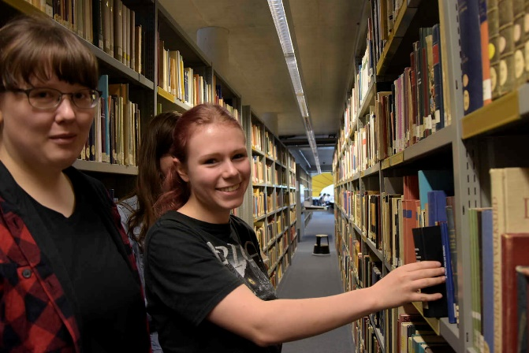
Notes:
Some pictures showing different situations for collaborative information seeking
CIS can be a distibuted process which involves the use of searchsystems … but it can also be co-located and is not necessairly carried out using a system
What we can also see is diversity in this pictures – it may involve young people, i.e. children, elderly people and the teams searching together may be heterogenous as well
Question for participants.
Which CIS situations did you experience?
How did you solve the tasks?
Work-tasks vs. leisure time?

Slide 16
Dejavnosti skupin v času in prostoru
Co-located
group interview
notices
Post-it notes
book issue
OPAC (physical)
memos
user education
User education
(ref material)
Synchronous
Asynchronous
telephone
Virtual reality
Social
Information
filtering
OPAC (network)
email
video conferencing
shared workspace
voicemail
remote databases
postal services
Internet
Remote
(Twidale & Nicholas 1996)
Notes:
As we can see form your examples for CIS, there are several different options for carrying ou gwgroup activities
And a way to describe them ist to look on them from the perspectives of time
And space
In generela the can be co-located or remote
And synchronous and asynchornous
Depending on the way we carry out group activities, we may need different kind of systems to support it
For instance skype or telephone for synchronous adn remote
Instant messangers can support both: synchronous or asynchonous and remote
… and sometimes also co-located
(example wehn two people send each other What‘sApp messages but are at the same place … (terrible!)

Slide 17
Zavedanje
“razumevanje dejavnosti drugih, ki omogoča kontekst za lastno dejavnost “ (Dourish&Belotti 1992)
Značilnosti, npr.:
Zavedanje skupine
Zavedanje delovnega prostora
Zavedanje konteksta
(Gutwin&Greenberg 2002)
Zadovoljivo zavedanje ➔ zmanjša stroške koordinacije in maksimira učinke sodelovanja (Shah & Marchionini 2010)
Notes:
Especially relevant in remote and asynchronous CIS
Insituations where we don need systems to carry out group work (so, when we are NOT at the same place) awareness ist a relevant aspcet
Awareness
Awareness, in the context of CSCW, has been defined as "an understanding of the activities of others, which provides a context for your own activity". The following four kinds of awareness are often discussed and addressed in the CSCW literature:
Group awareness. This kind of awareness includes providing information to each group member about the status and activities of the other collaborators at a given time.
Workspace awareness. This refers to a common workspace that the group has where they can bring and discuss their findings, and create a common product.
Contextual awareness. This type of awareness relates to the application domain, rather than the users. Here, we want to identify what content is useful for the group, and what the goals are for the current project.
Peripheral awareness. This relates to the kind of information that has resulted from personal and the group's collective history, and should be kept separate from what a participant is currently viewing or doing.
Shah and Marchionini^{[34]} studied awareness as provided by interface in collaborative information seeking. They found that one needs to provide "right" (not too little, not too much, and appropriate for the task at hand) kind of awareness to reduce the cost of coordination and maximize the benefits of collaboration.
Dourish, P. and Bellotti, V. (1992). Awareness and coordination in shared workspaces. In Proceedings of ACM CSCW, pages 107–114, Toronto, Ontario.Belo

Slide 18
Primeri CIS sistemov
Ariadne (Twidale et. al):
Vizualizacija (družbenega) procesa iskanja
SearchTogether (Morris & Horvitz)
Omogoča skupinam oddaljenih uporabnikov, da sinhrono ali asinhrono sodelujejo ob iskanju na spletu
Coagmento (www.coagmento.org, Shah)
Delo na projektih z več seansami ali več uporabniki v brskalniku

Slide 19
SearchTeam
SearchTeam
Posamezniki ali skupine
Možno je ustvariti nov SearchSpace in omogočiti skupno iskanje za vsako iskalno temo
SearchSpace
Iskanje informacij
Shranjevanje povezav
Skrivanje povezav
Nalaganje pomembnih dokumentov
Organizacija rezultatov ➔ mape
Pisanje opomb za člane teama
Chat (virtualni pogovor) s člani teama
…
www.searchteam.com

Slide 20
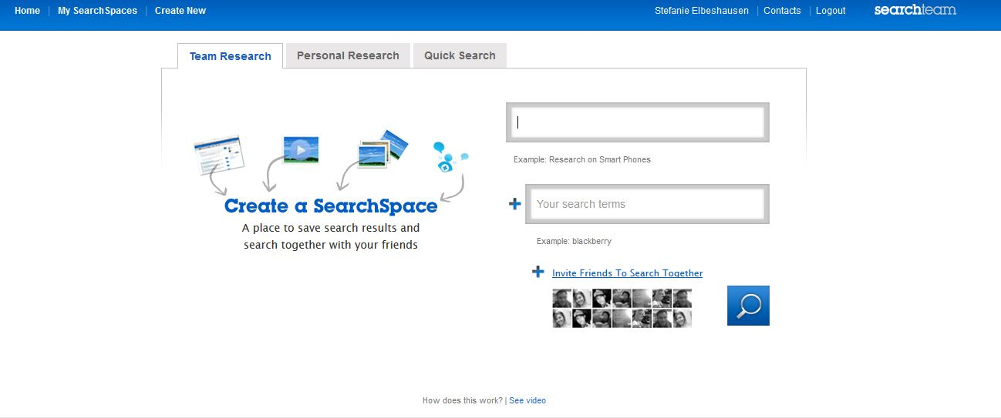
SearchTeam – Ustvarjanje SearchSpace

Slide 21
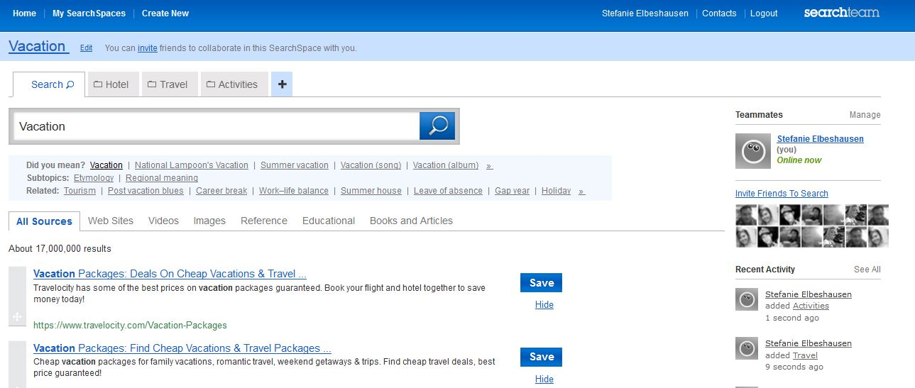
SearchTeam – Primer SearchSpace

Slide 22
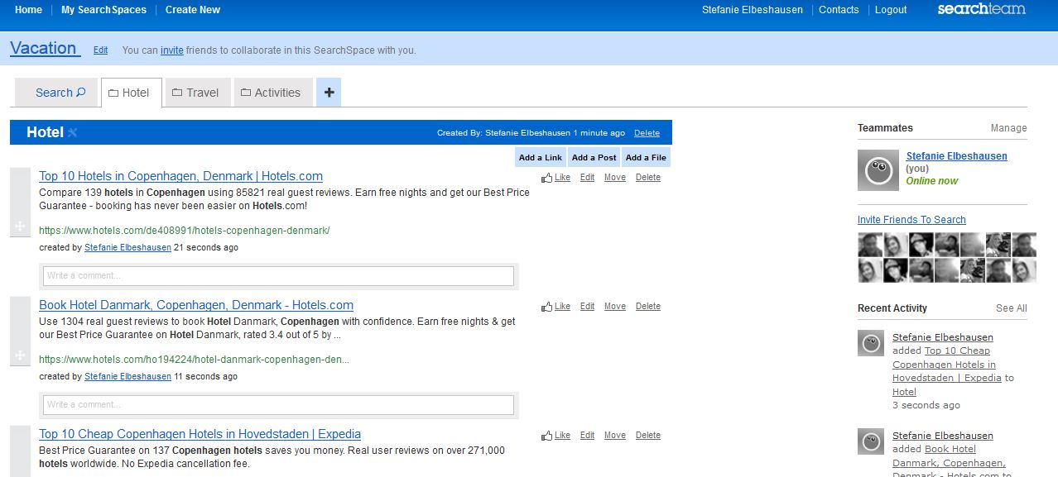
SearchTeam
Notes:
recent activities of teammembers, seeing who is online ➔ group awareness

Slide 23
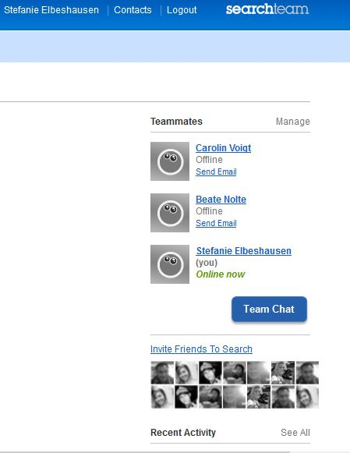
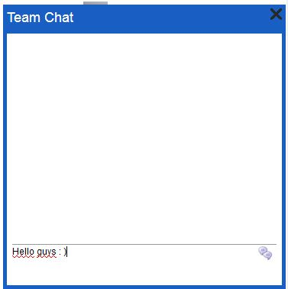
SearchTeam - Chat
Notes:
Team chat ➔ communication = one central aspect of collaboration

Slide 24
Vrednotenje CIS?
Notes:
You will hear more about evaluation later so I wonÄt go into detail here are just some examples
In general, it is difficult to evaluate CIS because it is very complex and a lot of different variables have to be taken into account
different users, different judgemnts for relevance, different backgrounds …
Traditional measures as recall and precission do not really work because CIS is about exploring something more and using a variety of systems and so on

Slide 25
Vrednotenje
Jette Hyldegård, Morten Hertzum and Preben Hansen: Studying Collaborative Information Seeking: Experiences with Three Methods
In: Hansen, Shah, Klas (2015)
Notes:
You will hear more about evaluation later so I wonÄt go into detail here are just some examples
In general, it is difficult to evaluate CIS because it is very complex and a lot of different variables have to be taken into account
Three examples for different research methods to evalaute CIS
i.e. task structured observation in the patent domain
Kurz erläutertn
as you can see, this research method is time consuming due to the qualitative approach and the longitudinal design
Same for me during my research for the phd ➔ a lot of data, difficult to observe and analysis thakes a long time as well …

Slide 26
Vrednotenje
CIS in Healthcare
Scientific Teams
CIS in Education
CIS in Patent
Kristine Newman, Simon Knight, Preben Hansen, Stefanie Elbeshausen: Situating CIS – The importance of Context in Collaborative Information Seeking
In: Hansen, Shah, Klas (2015)
Notes:
Evcaluating CIS in different domains ➔ here four different areas: healthcare, science, education, patent
In alln those areas CIS is carried out in different ways ➔ so it is dependent on the context
That again means we have to keep in mind that evalaution is depending on the context as well

Slide 27
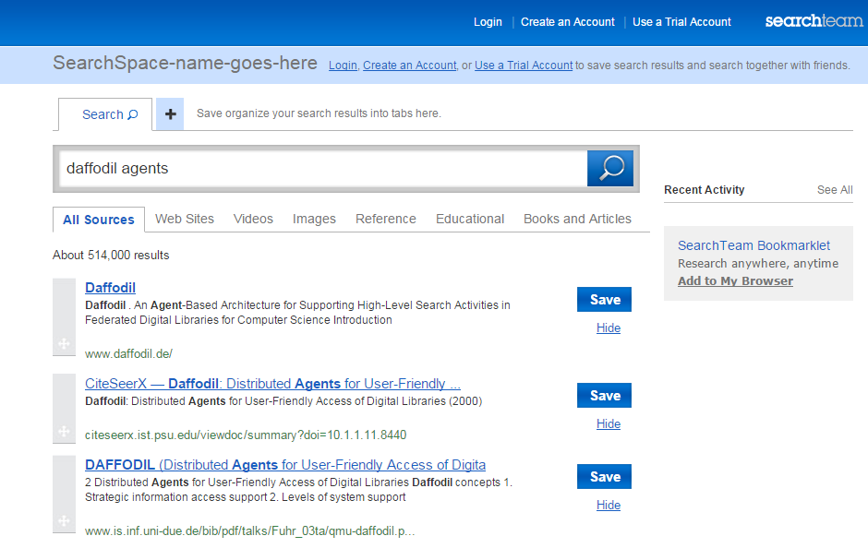
Vrednotenje
Prostočasno iskanje: Malezija
Situacije z delovnimi nalogami
Na daljši rok (2 tedna): Obširno iskanje, visoka kompleksnost
Za pisanje seminarja
Stefanie Elbeshausen, Thomas Mandl, Christa Womser-Hacker: Collaborative Information Seeking in the Context of Leisure and Work Task Situations
In: Hansen, Shah, Klas (2015)
Notes:
And CIS is not only carried out in professional or work task contexts but also as leaisure search
Kurz erläutern

Slide 28
Zaključek
CIS je uporabna metoda za reševanje kompleksnejših nalog
CIS je vsakodnevna dejavnost. Zato je pomembno, da jo poznamo
Npr., za gradnjo orodij za pomoč
Udeleženci imajo skupen cilj, iskanje je koristno za vse, namensko in eksplicitno
Notes:
It makes search more efficent because you can split up the task into sub-tasks and than gather the answers of all the participants
But we should alos keep in mind that it is a costly process which involves communication, contribution, coordination and cooperation

Slide 29
Zaključek
Kontekst je pomemben (prosti čas, služba, uporabniki, zahtevnost naloge, domena, … )
Vrednotenje je zahtevno
Kako meriti stroške sodelovanja? Kako meriti koristi?
Kako meriti rezultat teama?
Kako meriti prispevek posameznikov v skupini?
…
Notes:
… so there is still a lot of space for research in CIS!

Slide 30
Instructor Contact Information
stefanie.elbeshausen@uni-hildesheim.de

Slide 31
Literatura
Case , Donald O. 2002. Looking for Information: A Survey of Research on Information Seeking, Needs, and Behavior. San Diego, CA: Academic Press.
Dourish, P. and Bellotti, V. 1992. Awareness and coordination in shared workspaces. In Proceedings of ACM CSCW, pages 107–114, Toronto, Ontario.
Elbeshausen, S.; Mandl, T.; Womser-Hacker, C. 2014: Searcher heterogeneity in collaborative information seeking within the context of work tasks. In Proceedings of the 5th Information Interaction in Context Symposium (IIiX '14). Regensburg, Germany. 327-329. DOI=10.1145/26737002.2637054
Ellis, D. 1989. A behavioural model for information retrieval system design. Journal of Information Science, 15:237–247.
Gutwin, C. & Greenberg, S. 2001. A Descriptive Framework of Workspace Awareness for Real-Time Groupware. Computer Supported Cooperative Work, Kluwer Academic Press.
Hansen, P., Shah, C., Klas, C-P. 2015. Collaborative information seeking : best practices, new domains and new thoughts. Cham: Springer.
Heinström, J. 2002. Fast surfers, Broad scanners and Deep divers. Personality and information-seeking behaviour. Dissertation. Abo Akademi University, Abo, Finnland. Department of Information Studies. http://users.abo.fi/jheinstr/thesis_heinstrom.pdf
Hyldegard, J. 2006. Collaborative information behaviour - exploring Kuhlthauʼs Information Search Process model in a group-based educational setting. In Information Processing and Management, 42, 276-298.
Kuhlthau, C. C. 1991. Inside the Search Process: Information Seeking from the Userʼs Perspective. In Journal of the American Society for Information Science and Technology, 42(5), 361-371.
Notes:
Überarbeiten –
Collaborative information seeking : best practices, new domains and new thoughts verwendete Literatur bzw. generelle Literatur zu CIS und IS.

Slide 32
Literatura
Järvelin, K. & Ingwersen, P. 2004. Information seeking research needs extension towards tasks and technology. Information Research, 10(1) paper 212.
Ingwersen, P. & Järvelin, K. 2005. The turn: integration of information seeking and retrieval in context. Dodrecht: Springer.
Kuhlthau, C.C. 2004. Seeking meaning A process approach to library and information services. Westprot: Libraries Unlimited.
Kußmann, T.; Elbeshausen, S.; Mandl, T.; Womser-Hacker-C. 2013. Discovering Ellis‘ Phases of Information Seeking Behavior in Collaborative Search Processes. In Proceedings of Collaborative Information Retrieval Workshop at CSCW 2013. San Antonio, Texas.
Marchionini, G. 1995. Information Seeking in Electronic Environments. Cambridge University Press.
Shah, C. 2009. Lessons and Challenges for Collaborative Information Seeking (CIS) Systems Developers. In GROUP 2009 Workshop on Collaborative Information Behavior. Sanibel Island, Florida.
Shah, C., & Marchionini, G. 2010. Awareness in Collaborative Information Seeking. Journal of American Society of Information Science and Technology (JASIST), 61(10), 1970-1986.
Shah, C. 2012. Collaborative information seeking. The art and science of making the whole greater than the sum of all. Berlin, London: Springer (The information retrieval series, 34)
Twidale, M.B. & Nichols, D.M. 1996. Interfaces to support Collaboration in Information Retrieval. Technical Report, Lancaster University.
Wilson, T.D. 1999. Models in information behaviour research", Journal of Documentation, 55(3), pp.249 – 270.

