Slide 1
Measuring Library and Information Services
EINFOSE
http://einfose.ffos.hr/
Kornelija petr balog | eis

Slide 2
„Measuring performance is an exercise in measuring the past. It is the use of that data to plan an improved future that is all important.” – Peter Brophy (2006)
“What is easy to measure is not necessarily what is desirable to measure.” – Martha Kyrillidou (1998)

Slide 3
Performance measurement drivers
Accountability (including academic accreditation)
Advocacy
Rapid changes in socio-info-techno environments
Budgetary pressures
Improvement
Comparisons

Slide 4
Terminology
Inputs
resources which contribute to development and delivery of programs and services
Outputs
resources & services produced and their use. Processes turn inputs into outputs.
Outcomes
the effect of the library on the individual or the community
Performance indicators/measures
quantified statements used to evaluate the performance of the library in achieving its objectives
Benchmarking
measurable performance goal which is a standard of progress for success (or best practices)
Efficiency
Effectiveness
Metrics and measures – often used interchangeably; usually quantifiable

Slide 5
Library A
Circulation: 10.000 vol per year
Collection: 8.000 vol
FTE: 2
Whose workload is higher?
Library B
Circulation: 36.000 vol per year
Collection: 50.000 vol
FTE: 7
Performance indicators: A B
Circulation/collection 1,25 0,72
Circulation/FTE 5.000 5.143

Slide 6
Library A:
Cataloguing department: 2 FTE cataloguers
Salary: 2.000 euro x 2 = 4000 euro
Records per month: 100
Records/FTE: 50
Records/salary: 40 euro
Library B:
Cataloguing department: 2 FTE cataloguers
Salary: 2.000 euro x 2 = 4000 euro
Records per month: 600
Records/FTE: 300
Records/salary: 6,66 euro
Which is more efficient?

Slide 7
What can be evaluated in a library

Slide 8
Library as a complex system
Evaluation (methods and metrics) depends on view of a library
Institutions (organizations)
Information systems
New technologies
Collections
New services

Slide 9
Main concepts: streams, structures, spaces, scenarious, societies
Libraries are complex systems that
help satisfy info needs of users (societies)
provide info services (scenarios)
organize info in usable ways (structures)
present info in usable ways (spaces)
communicate info to users (streams)

Slide 10
Elements under evaluation
usefulness
system
impact/outcome
content
functionality
user
context
service
performance
organization
usability
usage

Slide 11
Library metrics: inputs
Focus on how big/how much
Budgets (staff, collections, operations)
Staff numbers
Collections sizes
Facilities
Other related infrastructure (hours, seats, computers)
Size of user communities and programs
Ratios (staff per student)
ARL “Investment Index” measures inputs related to expenditures and staff numbers
Notes:
Starting in 2005–06, ARL is calculating a Library Investment Index (previously named Expenditures-Focused Index) as an alternative to the historical index known as the ARL Membership Criteria Index. The Library Investment Index replaces the public availability of the ARL Membership Criteria Index and is retroactively calculated for the 2002-03 to 2005-06 data. The Library Investment Index is highly correlated with the Membership Criteria Index and less affected by changes in the collections variables. The methodology behind this new index is described by Bruce Thompson in his October 2006 paper, "Some Alternative Quantitative Library Activity Descriptions/Statistics that Supplement the ARL Logarithmic Index.„
The principles and procedures for academic library membership in ARL are based partly on quantitative data that provide a view of the range of resources deployed among the existing members of the Association. However, the ARL Index does not attempt to measure a library's services, quality of collections, or success in meeting the needs of users. Rather, it is a summary measure of relative size among the university library members of the Association.
The ARL Library Investment Index calculates principal component scores and the analysis is based on all university member libraries' data. The variables used in the Index were determined by factor analysis. These variables are: Total Library Expenditures (totexp) Salaries & Wages Professional Staff (salprf) Total Library Materials Expenditures (explm) Professional plus Support Staff (totstf)

Slide 12
Library metrics: outputs
Focus on usage
Collections (print, electronic, ILL)
Reference/information services
Facilities (gate counts)
Instruction sessions
Discovery and retrieval
Other Web sessions
Ratios (circulation per faculty)
May indicate if “inputs” are used, but doesn’t measure user impacts/outcomes

Slide 13
Library metrics: processes
Time/Efficiency (e.g., time to catalog a book)
Costs/Economy (cost per article download )
Quality/Accuracy
Quantity/Workload
Infrastructure measures (facilities, computing)
Covers conversion of inputs into outputs and used for accountability and budget

Slide 14
Two major trends in library assessment and performance measurement since 1995
Customer-centered library
All services and activities are viewed through the eyes of the customers
Customers determine quality
Library services/resources add value to the customer
Performance measurement
Move from inputs/outputs to processes/outcomes
More extensive range of data sources; systems generated data
Standardized definitions
Greater use of benchmarking
Ties to strategic planning, accountability, advocacy
Focus on users has led to outcomes-based metrics

Slide 15
Outcome-based metrics
Input
Processes
Output
Outcomes
Impact
(benefits)
Value
Outcomes*
pre-defined effects of the output related to goals and objectives of the library’s planning (e.g. number of users, user satisfaction levels)
Impact
difference or change in an individual or group resulting from the contact with library services
Value
the importance that stakeholders (funding institutions, politicians, the public) attach to libraries (monetary value may be included)
*R. Poll

Slide 16
Impact
on individuals
changes in skills and competences
changes in attitudes and behavior
higher success in research, study, or career
individual well-being
social impact
social inclusion
free and equal access to information
education, life-long learning
local culture and identity
health care
economic impact
ROI, cost-benefit
direct influence on economic life (local, regional, etc.)

Slide 17
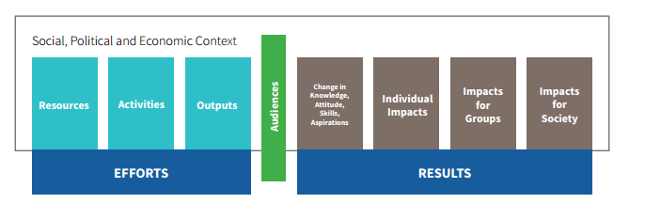
Library outcomes context

Slide 18
Outcomes*
Short
Change in knowledge, skills, attitudes, aspirations
Medium
Change in behavior, actions, decision making
Long-term
Change in status, conditions of life
*Shaping Outcomes

Slide 19
What sort of outcome?
A young scout can distinguish between various types of local birds
(short-term)
Children read for leasure more than 3 hrs a week
(medium-term)
A student does not think biology boring after a workshop in a library
(short-term)
Some inhabitants of Katlenburg have stopped smoking after being exposed to a lecture and exhibition in a Katlenburg public library
(long-term)

Slide 20
Methods for assessing impact
Inferred impact (data MUST be validated by other methods)
Statistics
Performance indicators
Results of user satisfaction surveys
Solicited evidence of impact (asking users and NON-USERS)
Surveys (in-house, telephone, e-mail, online), interviews, focus groups, self-assessment of users, collected anecdotal evidence
Results must be made quantifiable to show patterns of impact
Observed evidence
Observation, log analysis, tests for ascertaining an increase of skills and competences (e.g. prior and after a workshop)
Library use compared to customer success
Notes:
Statistics(libraries, cultural statistics, etc.)Example: Increase in library visits by children
The datamust bevalidatedbyothermethods
2.Performance indicators(especially indicators concerning usage)
Example: Higher market penetration in a target group
Results of user satisfaction surveys(perceived quality of library services)Example: High satisfaction with reference service
SOLICITED:
surveys(in-house, telephone, mail, online)
•street surveys
•interviews
•focus groups
•self-assessment of users
•collected anecdotal evidence (the story behind the data)The results must be made quantifiable to show patterns of impact(e.g. 80% of respondents say they have acquired new skills when using the reference service)
impactStreet survey What do you see as the most important functions of public libraries?
•Popular reading
•Area for study
•Access to information
•Children’s reading
•Internet access
•Local information
•Meeting place
impactSelf-assessmentPlease rate your self-confidence as follows (1=very confident, 5=not confident)
•Using an online catalogue to look up books 1 2 3 4 5
•Finding books on the shelf using call numbers 1 2 3 4 5
•Using a database to find periodical articles 1 2 3 4 5
•Writing a correct citation in a bibliography 1 2 3 4 5
•Finding sources on a specific topic on the Internet 1 2 3 4 5
•Evaluating an Internet source (authority, bias) 1 2 3 4 5
Observedevidenceof impact:
Example
Records of reference interviews were used for identifying whether library instruction had influenced the users’ knowledge and skills. Before each reference interview it was ascertained whether the user had attended a library instruction or not.
The questions and remarks of users with library instruction showed a higher degree of information literacy.

Slide 21
Economic impact
Can we express library’s impact in money-terms?
Calculation of market prices
Time spent on library services (calculated as prices)
Contingent valuation
willingness-to-pay
Willingness-to-accept
Does the library influence the economy of its surroundings?
What would users pay for the maintenance of a service?
What sum would users accept as equivalent for the abolition of a service.

Slide 22
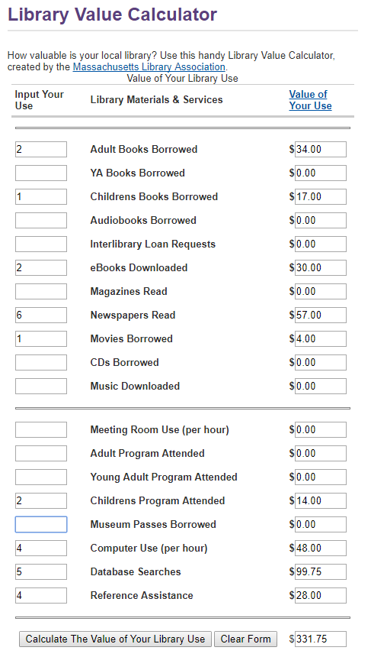
Library saves customers’ money by acquiring information resources on their behalf!

Slide 23
Return on investment (ROI)
Summing the assigned value, then dividing that total by all expenses
„for each dollar spent on the library, the community receives $..... in benefits from library service.”
Cortez Public Library, USA - $31 return
Denver Public Library, USA - $5 return
Fort Morgan Library, USA - $8.80
Australian special libraries - $5.43
…
Notes:
$1 invested yields $31 return

Slide 24
Problems of calculating the impact of libraries
The impact is for the most part intangible and difficult to quantify.
Long-term effects cannot be ascertained if the users are no more available.
The results of qualitative methods have a subjective bias.
Libraries are not familiar with the methods used for impact assessment.
The expenditure of time and effort can be considerable
The library’s influence is generally not the only and possibly not the strongest one.

Slide 25
Quality
Manner in which the service is delivered (i.e. not delivered)
(library) service quality
Interactive relationship between the library and the people it is supposed to serve
Multidimensional
Content
Context
Customer expectations – reality for customer!
Change according to what customers want and how urgently they want it –> importance and urgency – strong influence on customers’ satisfaction with a service
Personal and collective
Notes:
- Library that adheres to all the professionally approved rules and procedures, but has no customers, cannot claim quality because a major component is missing – satisfying people’s needs

Slide 26
Quality vs. Satisfaction
Service quality
Global judgement relating to the superiority of a service as viewed in the context of specific statements that the library is willing to act on IF customers find them of great value
Strongly related or not???
Material vs. emotional satisfaction
Individual positive impression of service
A number of transactions/encounters of an individual with a particular organization
Collective experience – create organization’s reputation

Slide 27
Other dimensions of service quality
Conformance
Standards for quality for many processes and functions
Intent: reduce mistakes (e.g. shelving errors), streamline workflow (e.g. cut backlogs), and establish required behaviors (e.g. ask if the customer got what was desired)
Downside: focus is internal and may not match customer expectations
Expectations
Influenced by prior experience, word of mouth and competitive behavior
Sometimes erroneous or unrealistic expectations

Slide 28
Cont…
Market perception
Evaluation against competitors
E.g. bookstores (read, and not buy, drink coffee, etc.); Netflix, iTunes – movies; iTunes, Pandora – music; Google – looking for information …
Questions:
Why don’t more people use us (libraries)? What do we do better than other service organizations (including other libraries)? How do we alert customers to this?

Slide 29
Benchmarking
Benchmarking is concerned with use of best practices within and between organizations. Often done with peer libraries using input and output data from:
Salaries
Staffing
Budgets
Collections
Services
Facilities
May express as ratios such as librarians per student, book expenditures per faculty, seats per student etc. Can also set service expectations for users.

Slide 30
Benchmarking
Are we doing better than we did in the past?
Internal
Competitive
Functional
Are we equally as good (or even better) than other service organization in our vicinity?
Are we better than our competitors?
Are we equally as good (or even better) than other service organization in our vicinity?
Are there quality service organizations in our vicinity we can learn from?

Slide 31
Prerequisites:
Libraries MUST HAVE a similar structure and mission statements
Performance indicators HAD TO BE USED IN THE SAME (or at least, similar) conditions

Slide 32
Benchmarking projects: Bibliotheksindex (BIX)
Bibliotheksindex (BIX) http://www.bix-bibliotheksindex.de/index.php
Academic and public libraries
From 1999-2015
Goal: to provide comparable statistical data for libraries

Slide 33
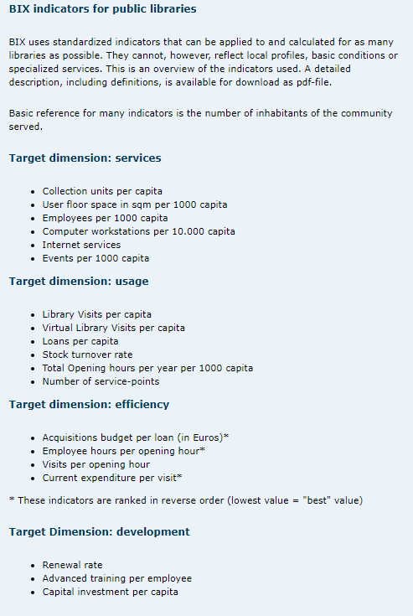
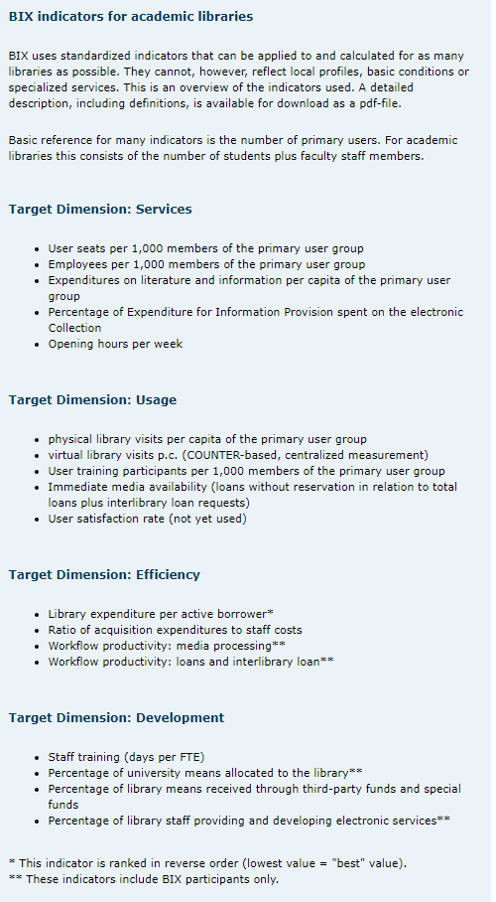
Notes:
17 indicators for academic and 18 for public libraries
4 dimensions: service, usage, efficiency and development

Slide 34
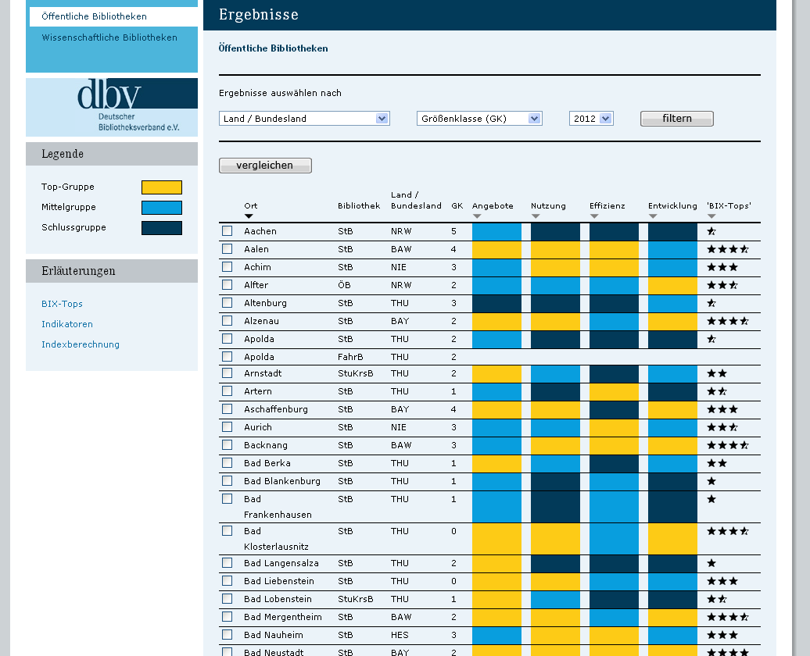

Slide 35
Benchmarking projects: America’s Star Libraries
Ranking of American public libraries by Library Journal – from 2008
Top-star libraries 2016 http://lj.libraryjournal.com/2016/11/managing-libraries/lj-index/class-of-2016/americas-star-libraries-2016-top-rated-libraries/#_
Compares libraries in the same budgetary class
Four indicators (per capita):
Circulation
Visits
Program attendance
Public Internet
Prerequisites for libraries:
Cater for population of min 1000
Min budget of $10.000
Quantitative measures

Slide 36
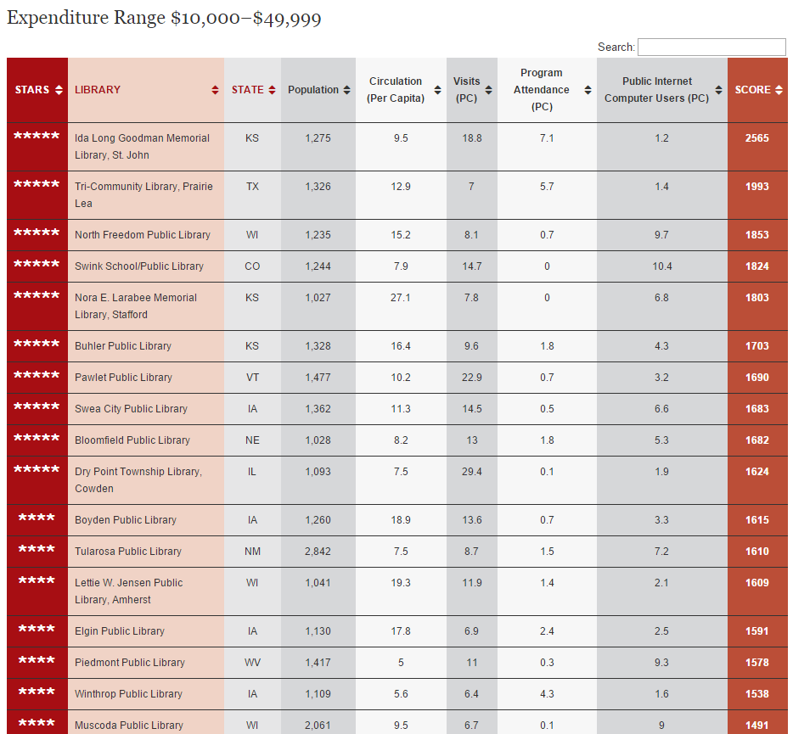

Slide 37
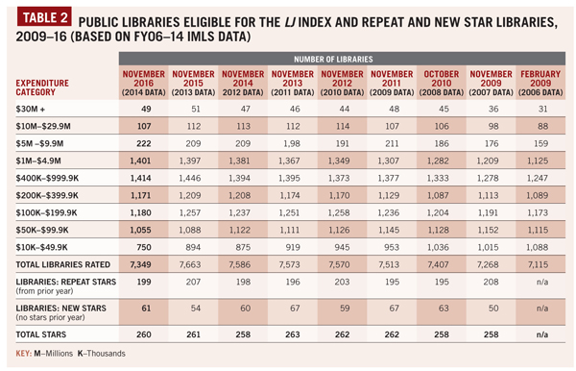
Source: Library Journal http://lj.libraryjournal.com/2016/11/managing-libraries/lj-index/class-of-2016/americas-star-libraries-2016-top-rated-libraries (2017-8-10)

Slide 38
Benchmarking projects: Library Ranking Europe (LRE)
From 2014 (pilot-project)
Currently – approx 30 public libraries rated
Star-system (1-6)
Customer-focused approach (mystery shopper)
Measures:
communication with the customer, marketing of the library, location and site, visibility and accessibility, service and supply, premises, choice of collection and function when it comes to freedom of expression, freedom of choice.
Notes:
Companies and institutions that produce goods or services often use ranking systems for development of their products. This includes for example hotels, restaurants, schools, universities and cities. Ranking is however an instrument that is not commonly used among public libraries. We are proposing a ranking system that stimulates benchmarking and strengthens the citizen and customer perspective.
It exists however already a variety of ranking and rating systems in the library sector. There are examples in USA, Great Britain and Germany, but they are mostly based on hard facts as economy, staff, circulation, visits and they are primarily indicating efficiency. Our initiative, Library Ranking Europe (LRE), is based on the perspective and the needs of the citizen and customer. We anticipate that the customer is more interested for example in personal service, supply of media and opening hours. The existing customer surveys do not always provide information that is useful for improving services .
This assessment, this ranking, is based on the Nordic public library tradition and ideology. In the Nordic countries public libraries are important for freedom of expression and democracy, culture, education, research and social development.
The ambition with LRE is to visit, observe and to rank European public libraries. We are using the method of Mystery shopping. Aspects we especially investigate are access to information about the respective library, location and the customer service. Site, visibility and accessibility are of main importance including public transport, handicap accessibility and opening hours. Services and supplies that are included in the surveys are for example media and fees, cafés, lavatories and identifiable staff. Architecture, aesthetics and premises, standard concerning lighting and facilities for children and youth are observed. The versatility of the library regarding supply of media and the presence of controversial titles and authors is also evaluated.
Evaluations are summarised in a scale of six levels, six stars being the highest level .

Slide 39
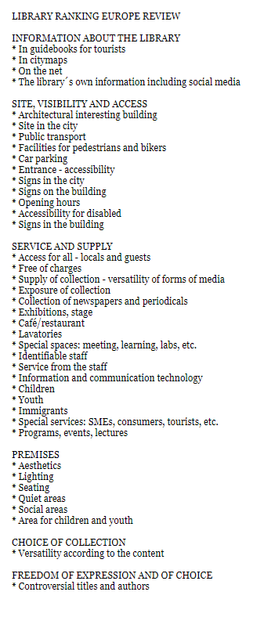
Criteria for assessment

Slide 40
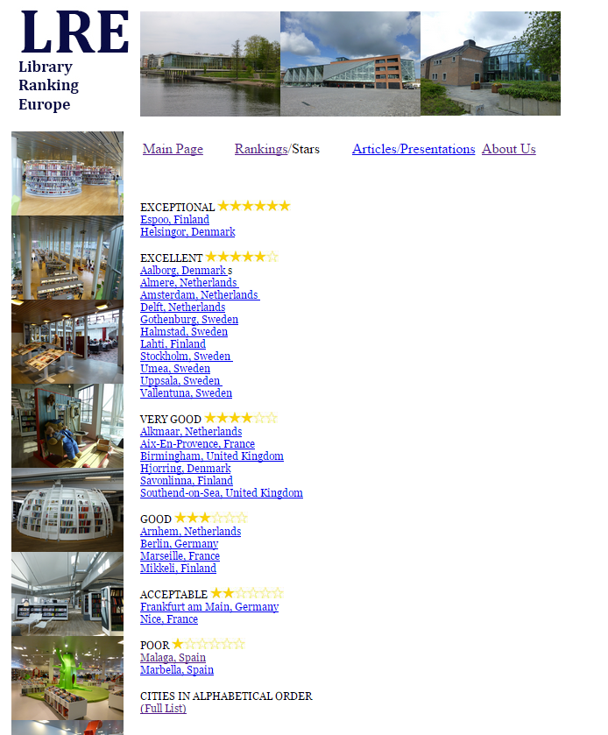
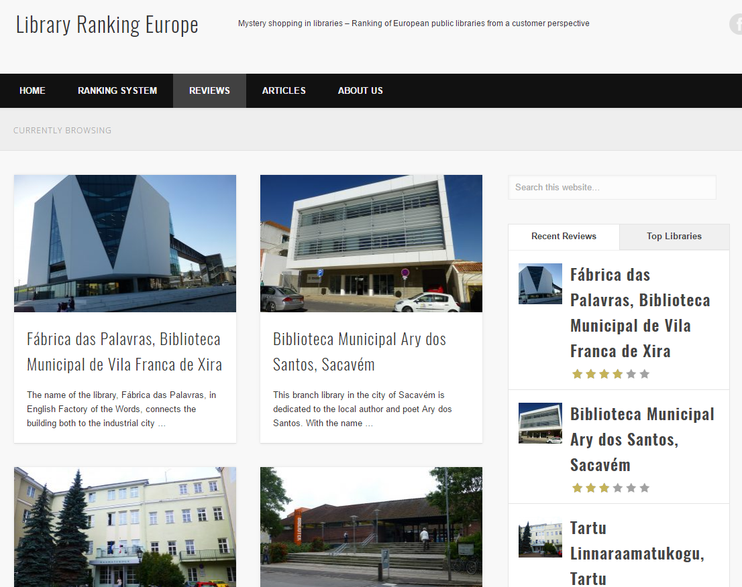

Slide 41
Instructor Contact Information
kpetr@ffos.hr

