Slide 1
Organization of information and IR
EINFOSE
http://einfose.ffos.hr/
Jan Pisanski / PIS&R

Slide 2
Different types of documents*
Text
Images (still and moving)
Audio (music, speech, other sounds)
Mixed
*What is a document

Slide 3
How can we find what we want/need?

Slide 4
How can we find what we want/need?
Text (full text)

Slide 5
What are the problems with full-text searching?
Journal articles as example

Slide 6
What are the problems of full-text searching?
Terminology
Different languages
Searching for particular characteristics (author, word in a title, journal title, year of publication…)

Slide 7
What about images and sound?

Slide 8
Solution: metadata
Structured information about the document
Standard structure: metadata elements
Standard rules and values (e.g. for dates, names; controlled vocabularies)
Standard encoding/format

Slide 9
Controlled vocabularies
Lists of possible/approved values
Codes for languages
Genre terms
…
Subject terms
Classification

Slide 10
Subject vocabularies
List of terms
Synonyms
Hierarchical relationship
Other relationships
Relationships enable exploration of the terminology and the domain

Slide 11
Examples from Dewey Decimal Classification
Notation | Hierarchically-contextualized caption
362.196462 | Social problems of and services to groups of people / People with physical illnesses / Medical services / Diabetes
616.462 | Medicine / Specific diseases / Diseases of endocrine system / Diabetes mellitus
616.46206 | . . . / Diabetes mellitus / Treatment
618.3646 | Medicine / Gynecology and obstetrics / Diseases and complications of pregnancy / Diabetes
618.92462 | Medicine / Pediatrics / Diabetes mellitus
641.56314 | Cooking for people with medical conditions / People with diabetes

Slide 12
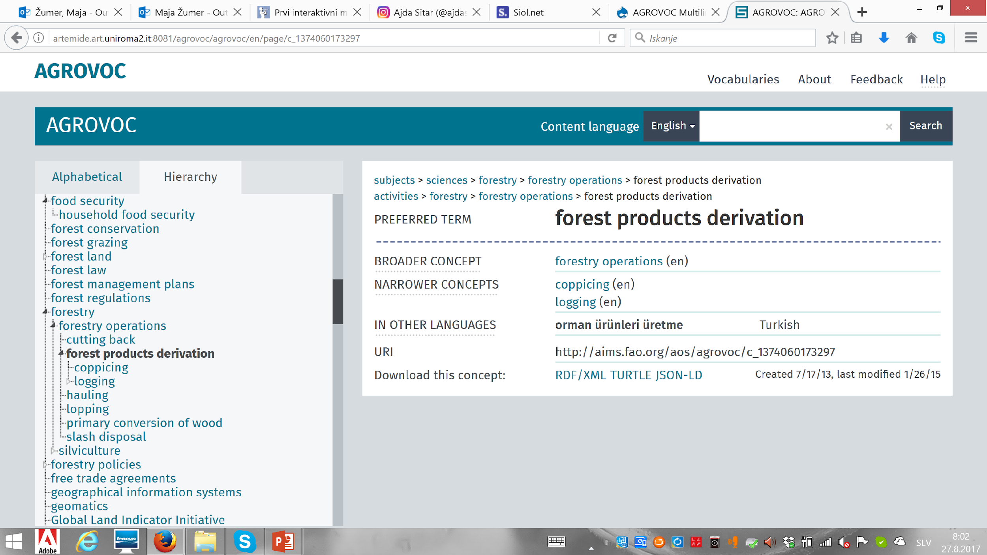

Slide 13
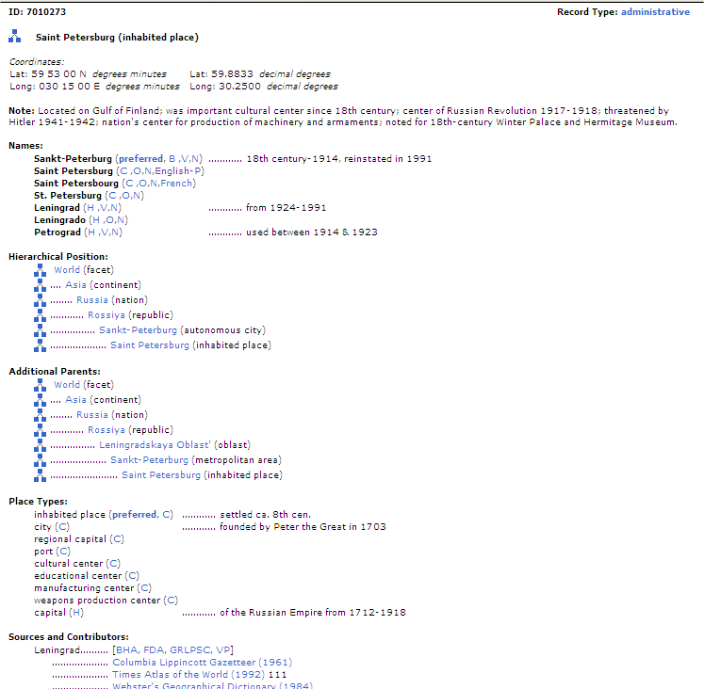

Slide 14
Authority control
Most often name authority control
Clustering all appellations (and choosing the preferred form)

Slide 15
Example
Shakespeare, William, 1564-1616. ‎ Shakespeare, William ‎ William Shakespeare ‎ Шекспир, У. 1564-1616 Уильям ‎ Шекспир, Уильям, 1564-1616. ‎ شكسبير، وليام ‎ שיקספיר, ויליאם, 1564-1616 ‎ شكسبير، وليم، 1564-1616. ‎ Shakespeare, W. 1564-1616 William ‎ Shakespeare, William <pseud.> ‎ Shakespeare, William (English playwright and poet, 1564-1616)

Slide 16
Authority control
People, companies, groups as authors or subjects use different names
Randomly
Changing over time
Depending on circumstances
Is a mechanism that enables:
Searching on any form of name
Clustering all works by an author regardless of the form of the name

Slide 17
Organization of information
Long tradition
Libraries historically the main player
Even more important in the digital environment
While traditional methods are applicable, they are not scalable
Simplified ‚cataloguing‘
Automatic processing
Automatic indexing, classification
Similarity (from user behaviour)

Slide 18
Organization of information
enables locating and using information
The role of information science is to:
develop mechanisms and tools
evaluate them
study user needs
study user behaviour

Slide 19
Instructor Contact Information
Jan.Pisanski@ff.uni-lj.si

Slide 20
My contact
jan.pisanski@ff.uni-lj.si

